Slide 1
know ledge
understanding
ins t ruction
wisd m

Slide 2
1
2
instruction and/or discovery
knowledge
knowledge + wisdom understanding

Slide 4
Wisdom and Money Eccl 7:11-12a
Wisdom is as good as an inheritance, an advantage to those who see the sun. For the protection of wisdom is like the protection of money (NRSV)
Wisdom is good with an inheritance (KJV)
Wisdom is better when it’s paired with money (MSG)
Wisdom, like an inheritance, is a good thing (NIV)
Wise use of possessions is good (ISV)

Slide 5
Wisdom and Patience Eccl 7:8
Better is the end of a thing than its beginning; the patient in spirit are better than the proud in spirit. (NRSV)
Something completed is better than something just begun; patience is better than too much pride (CEB)
The end of a matter is better than its beginning, and patience is better than pride (NIV)
The end of something is better than its beginning, so the patient are better than the proud (CJB)
Finishing is better than starting. Patience is better than pride NLT)

Slide 7
Wisdom and Nostalgia Eccl 7:10
Don’t long for “the good old days.” This is not wise (NLT)
Do not say, ‘Why were the former days better than these?’ For
it is not from wisdom that you ask this (NRSV)
Do not say, “Why were the former days better than these?”
For you do not inquire wisely concerning this (NKJV)
Never ask, “Oh, why were things so much better in the old days?” It's not an intelligent question (GN)

Slide 8
Here’s how I think the Preacher in Eccesiastes would respond to people who say things like [fing’s ain’t wot they used t’ be]:
“If you think you’re living in a world where things are getting worse all the time, then cheer up: at least you’ll be dead before things get really bad.”
Gibson p.101

Slide 9
Qohelet’s answer to Gibson:
Eccl 3:11: “He has made everything suitable for its time;
moreover he has put a sense of past and future into their* minds; yet they cannot find out what God has done from the beginning to the end.”
[* “their” refers back to the toiling workers]

Slide 11
“Our Nostalgia Is Spiritually Dangerous”
Why we shouldn’t worship the golden calf of the ‘pre-COVID’ days.
Sabella writes about looking back to pre-covid days and reminds his readers of the Children of Israel in the desert longing for the fleshpots of Egypt. The euphoria of crossing the Red Sea giving way to eating manna every day. The absence of Moses, their leader, giving way to the worshipping of a golden calf. He writes: “But nostalgia so consumed them that they overlooked 400 years of bondage and broke the first and second commandments in order to conjure an idealized, distorted past. They lost their moral bearings so completely that God considered wiping them out before Moses intervened.”
Jeremy Sabella Christianity Today (Jan 15, 2021)

Slide 12
Sabella continues:
“C.S.Lewis points out that most vices, such as fear, ambition, or lust, tempt us to obsess about the future. Nostalgia, by contrast, is oriented toward the past. Since it nudges us in the opposite direction of most other vices, we tend to see it as innocuous by comparison. But spiritually speaking, that we lose contact with the present matters more than how. The longer a vice keeps us from facing the challenges and appreciating the blessings of our present, the more spiritually corrosive it becomes. And precisely because it feels pleasant and harmless, nostalgia can be devastatingly effective at throwing us out of sync with the work of the Spirit for prolonged stretches of time.

Slide 14
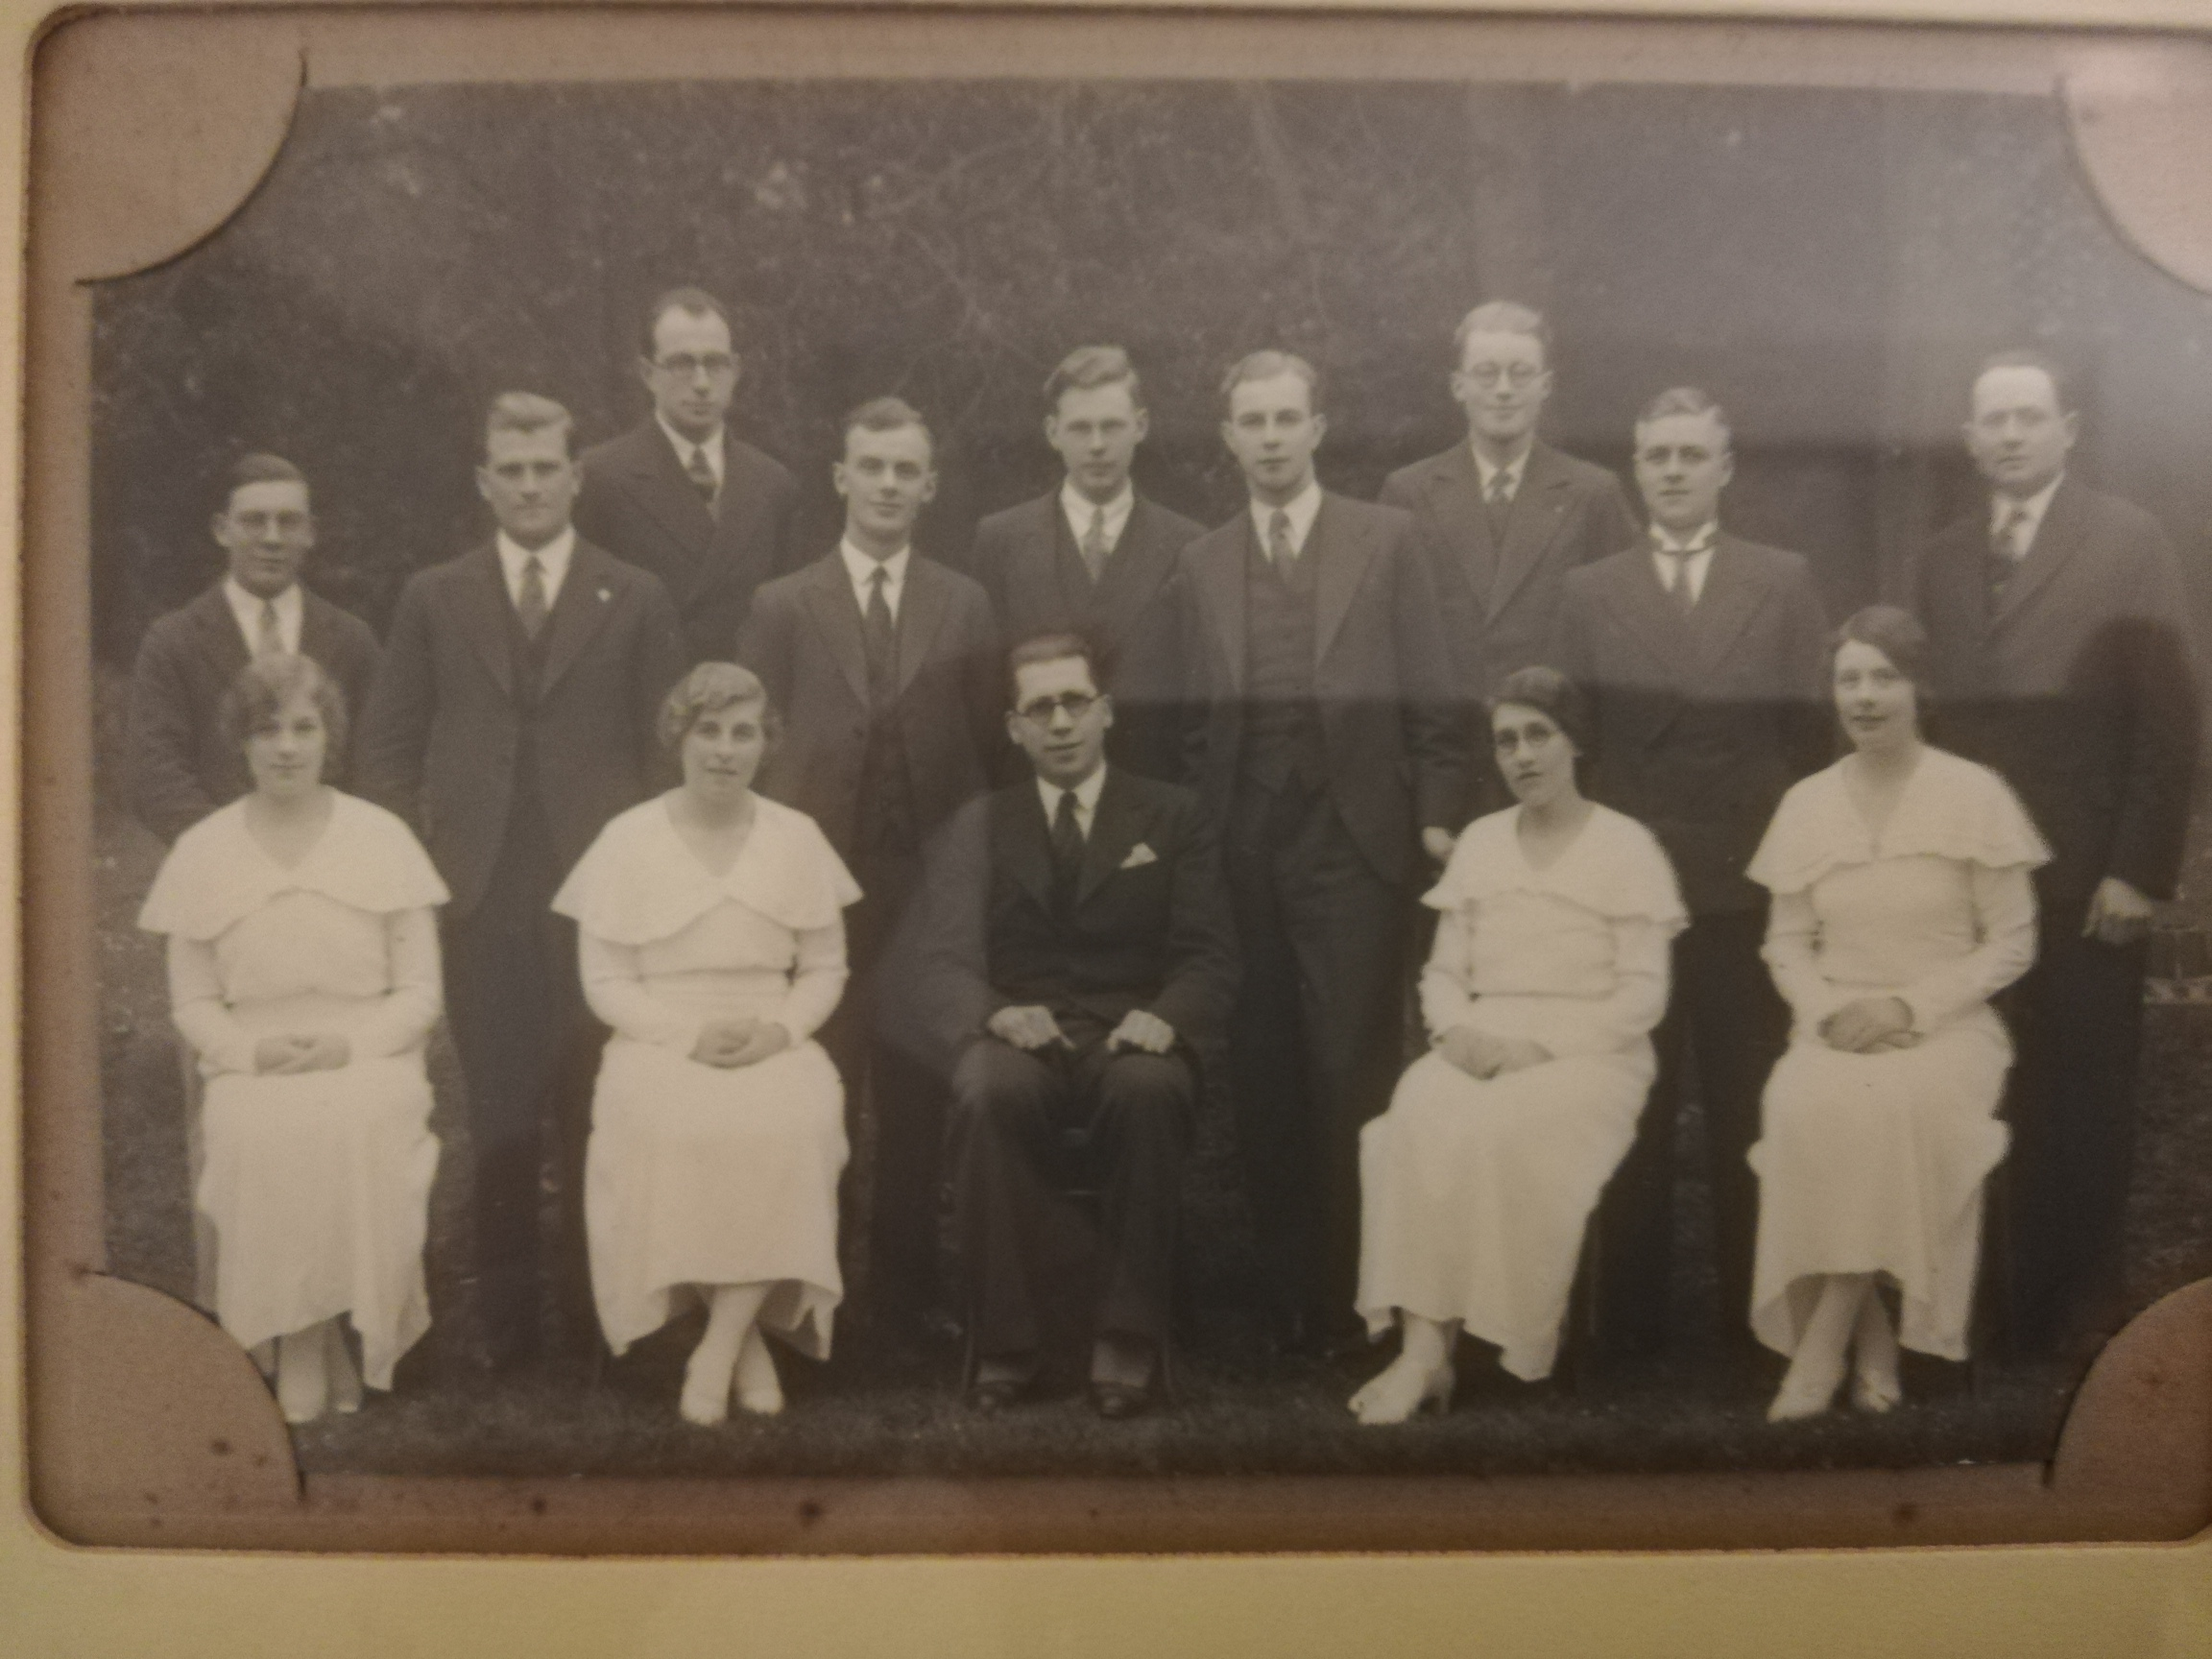

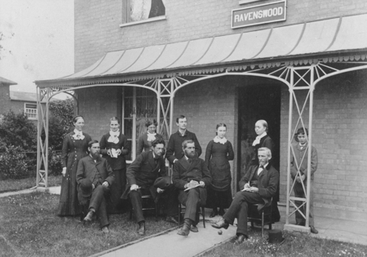
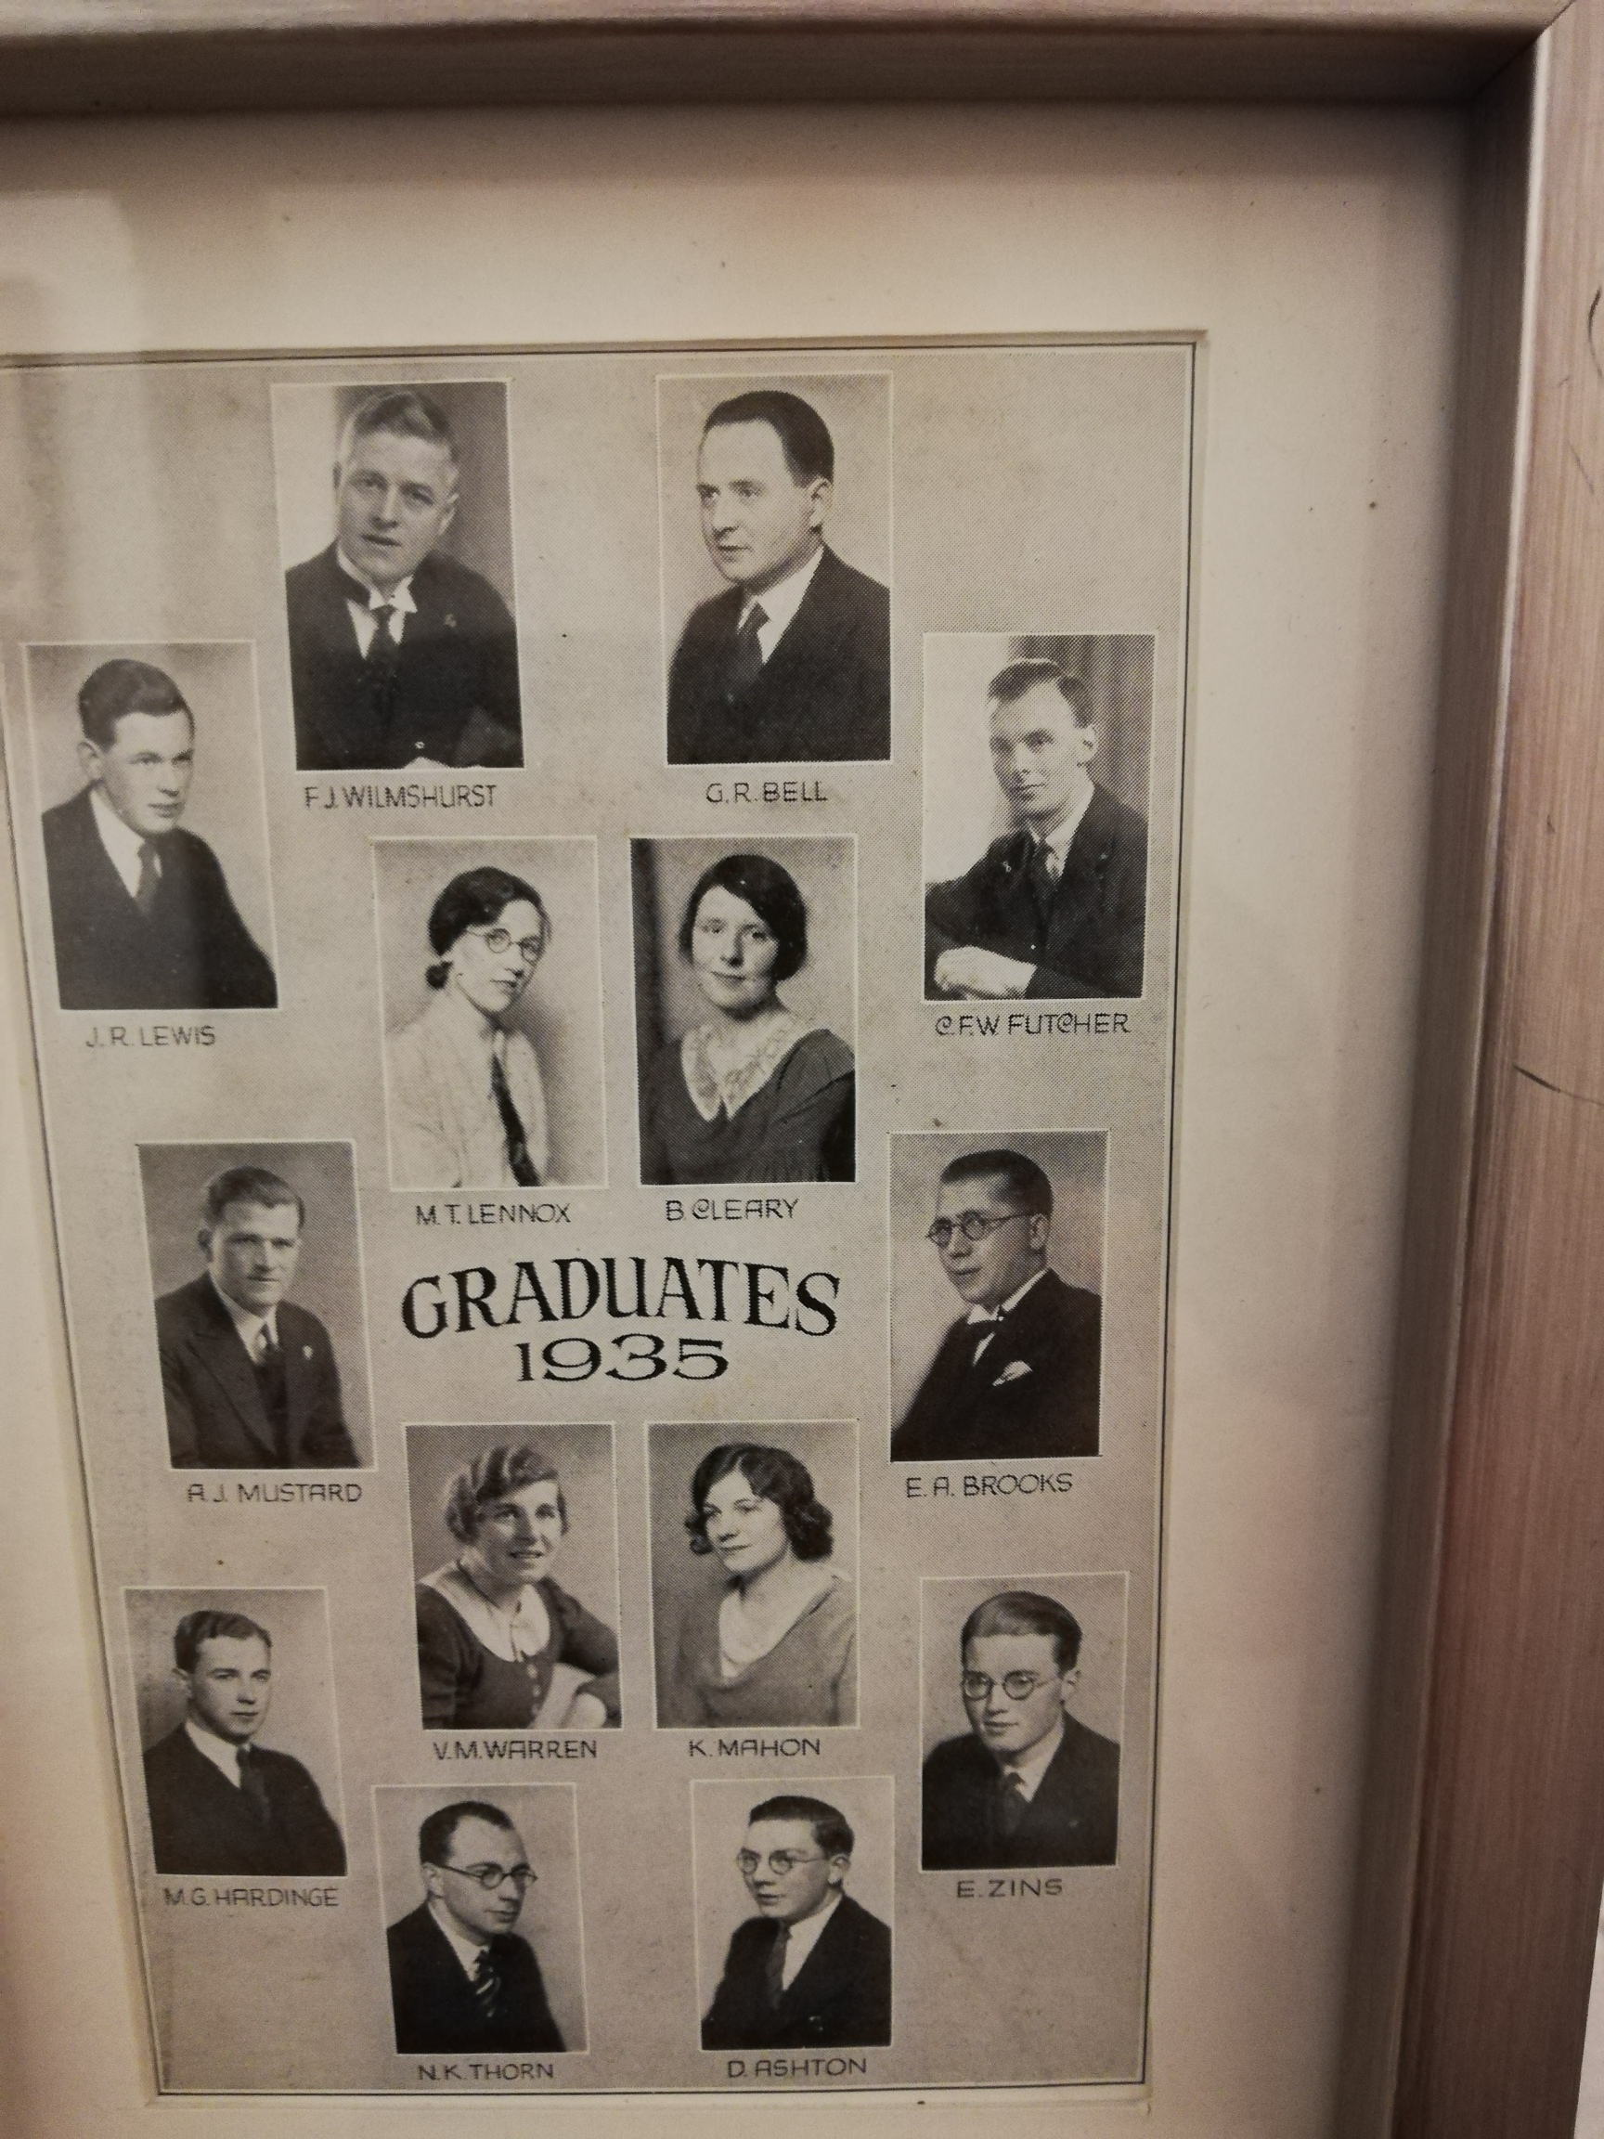
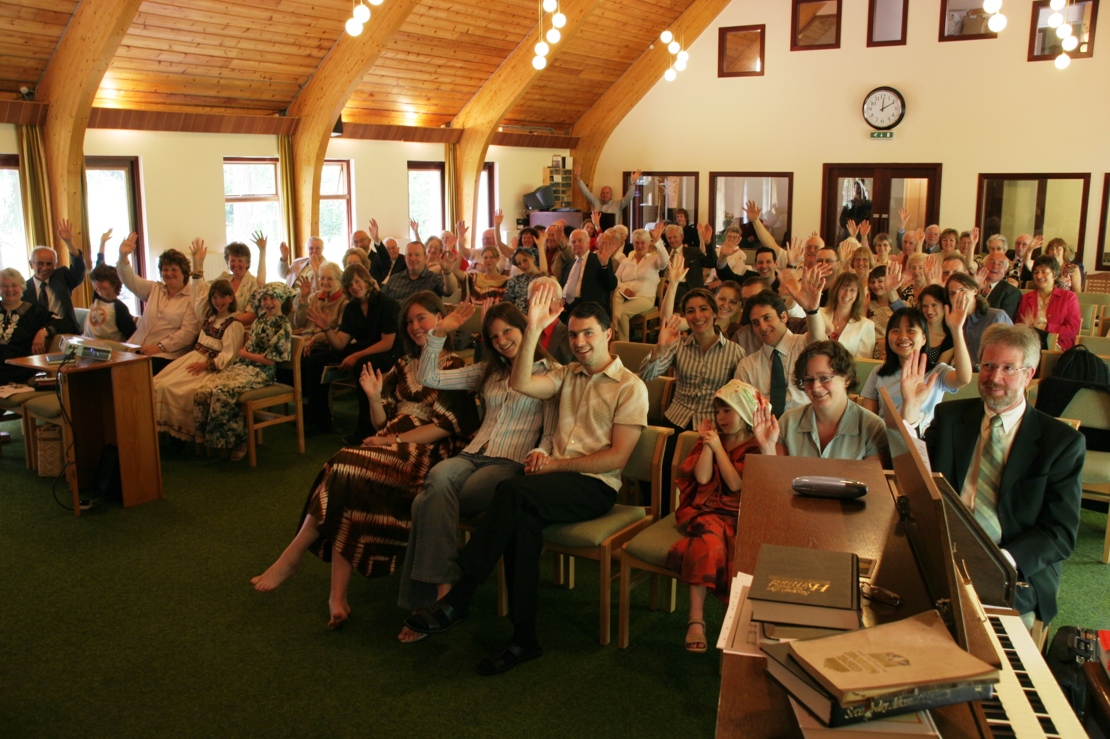
The Good Old Days of Adventism ???
“Gospel Melodies”

Slide 16
“Maybe the past was better than the present. But when you start asking “Why was it better?” what you are doing is denying the reality of God’s presence in the present. If you think things are worse, do you think God is no longer in control? Do you think he hasn’t brought you to the point where you are now and that he no longer loves you or has plans or purposes for you? To ask the question in verse 10 is unwise because it forgets about God. Often when we ask this it’s because we are blind to the good things of the present and ignorant of the evil of the past”.
Gibson p 101-2

Slide 17
“… Nostalgia is a form of escapism by taking a vacation in the past instead of grappling with the present or looking forward to the future of faith.”
Gibson p.102

Slide 19
“When you experience nostalgia, your heart is longing for a more beautiful person … or place than you have ever known. You think you’re longing for the past, but the past was never as good as your mind is telling you it was.
And, says C.S.Lewis, God is giving you in that moment one of the most profound glimpses of the intensity of perfection and beauty that you have actually yet to see. What is in fact pulling on your heartstrings is the future: it’s heaven; it’s your sense of home and belonging that has just cracked the surface of your life, for just a moment, and then is gone.”
Gibson p.103

Slide 20
“Wise people who understand how God has made us to long for him and for heaven don’t look backward when they get nostalgic. They allow the feeling to point forward. They look up to heaven and to home.”
Gibson p. 103

