Slide 1
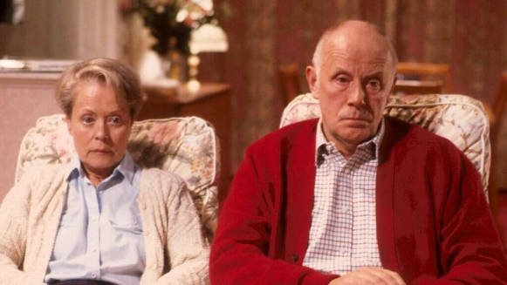
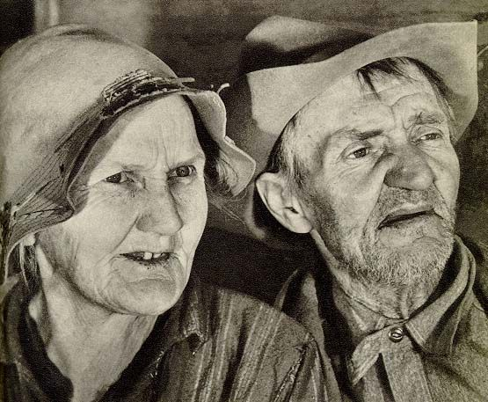
Week 16:
Qohelet, Gibson and Nouwen on getting old

Slide 2

For the under 50’s:
Eccl 11:9 – 12:1
⁹ Young person, if you spend your youth only having fun, if you use your early years just to entertain yourself, if you follow your heart as you live your life, and let your eyes be your guide; understand that for all these things God will bring you to judgment. ¹⁰ Therefore, remove anger from your heart; and keep from harming your body; for neither adolescence nor youth has any lasting value. So remember your creator while you are young . . .

Slide 3
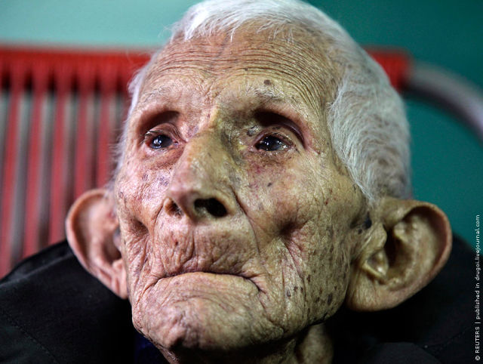
For the over 50’s:
. . . the evil days come, and the years approach when you will say, “They no longer give me pleasure”; before the sun and the light grow dim, also the moon and the stars; before the clouds return after the rain; on the day when the guards of the house are trembling, and men of courage are bent over double; when the women stop grinding grain, because there are so few; when the women at the windows can no longer see out . . .

Slide 4
. . . when the doors to the streets are kept shut;
when the noise from the grain-mill fades;
when a person is startled by the chirp of a bird,
yet their singing is hard to hear;
⁵ when they will be afraid to go up a hill,
and terrors will stalk the way,
even though the almond tree is in bloom;
when the locust can only drag itself along,
and the caper berry has no [aphrodisiac] effect —
because the person is headed for his eternal home,
and the mourners are already gathering
in the marketplace . . .

Slide 5
. . . before the silver cord is snapped
the bowl of gold is cracked,
the pitcher is shattered at the spring,
the pulley is broken at the cistern,
⁷ the dust returns to earth, as it was,
and the spirit returns to God, who gave it.
For interpretations of this poem see link on Week 16 of virtualvestry.com/current

Slide 6
12:7-8 Qohelet’s penultimate statement:
NRSV: The dust returns to the earth as it was, and the breath returns to God who gave it.
Vanity of vanities, says the Teacher; all is vanity.
CJB: The dust returns to earth, as it was, and the spirit returns to God, who gave it.
Pointless! Meaningless! says Kohelet, Nothing matters at all!
הֲבֵ֤ל hā·ḇel
breath, vapour, worthless, futile, ephemeral,
fleeting, absurd, senseless, irrational, a violation
of reason, incomprehensible

Slide 8
Sheol (the “underworld”)
9:5, 10 For the living know that they will die, but the dead know nothing; there is no longer any reward for them, because all memory of them is lost . . . Whatever task comes your way to do, do it with all your strength; because in Sheol, where you will go, there is neither working nor planning, neither knowledge nor wisdom.

Slide 9
Sheol (the “underworld”)
In Hebrew thought Sheol was
“A dreary realm of darkness,
inertia and eternal sleep”
- Jewish Publication Society commentary on Ecclesiastes, p 64
63 refs to Sheol in the HB/OT:
Genesis (4) Numbers (2) Deuteronomy (1) 1 Samuel (1) 2 Samuel (1) 1 Kings (2) Job (8) Psalm (15) Proverbs (9) Ecclesiastes (1) Isaiah (10) Ezekiel (5) Hosea (1) Amos (1) Jonah (1) Habakkuk (1)
(These are listed on virtualvestry under week 16)

Slide 10
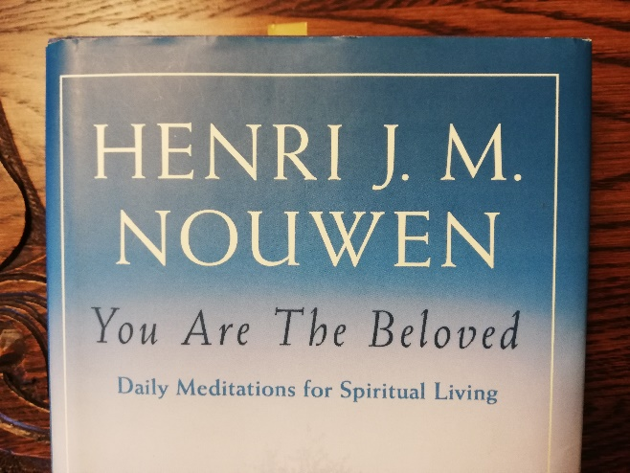
Henri Nouwen writes about Death

Slide 11
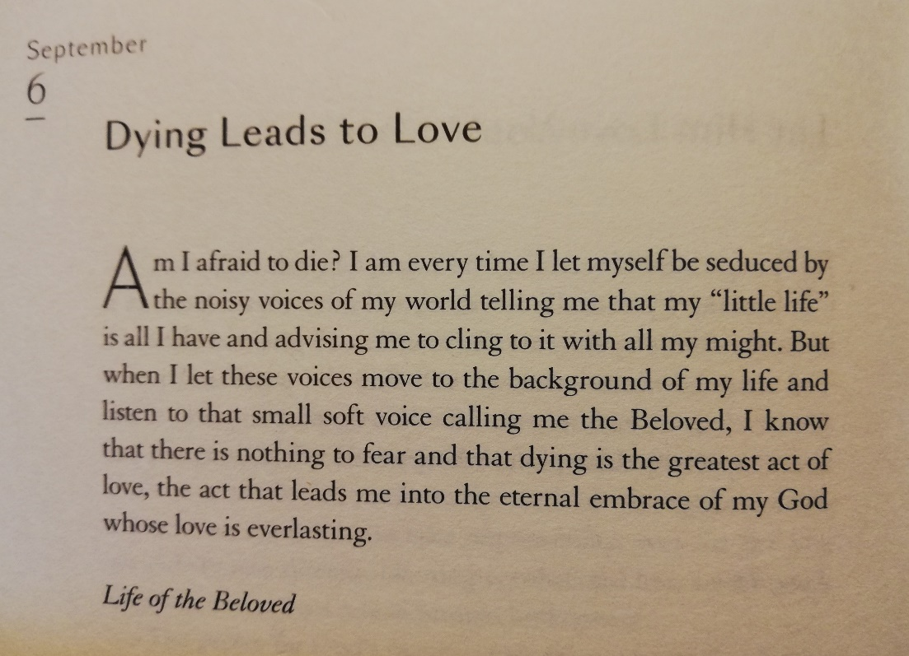

Slide 12
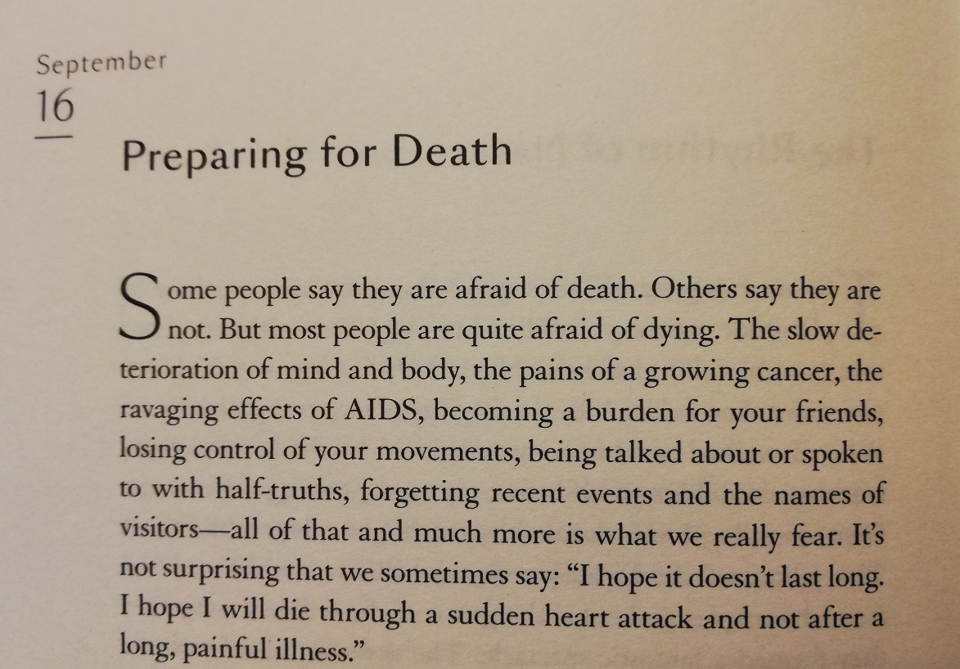
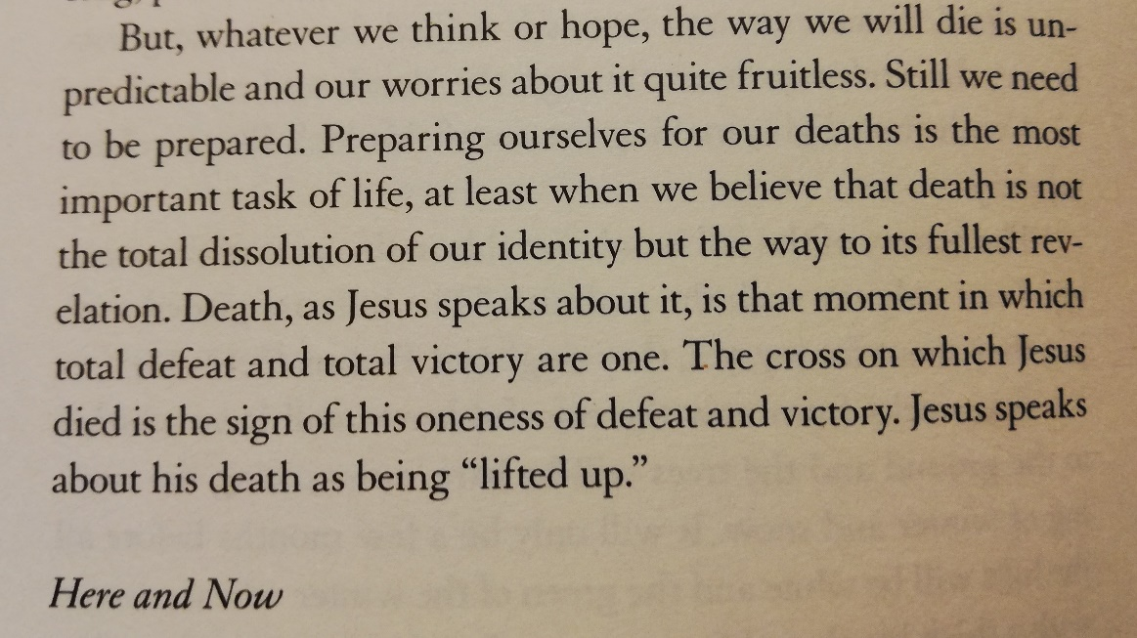

Slide 13
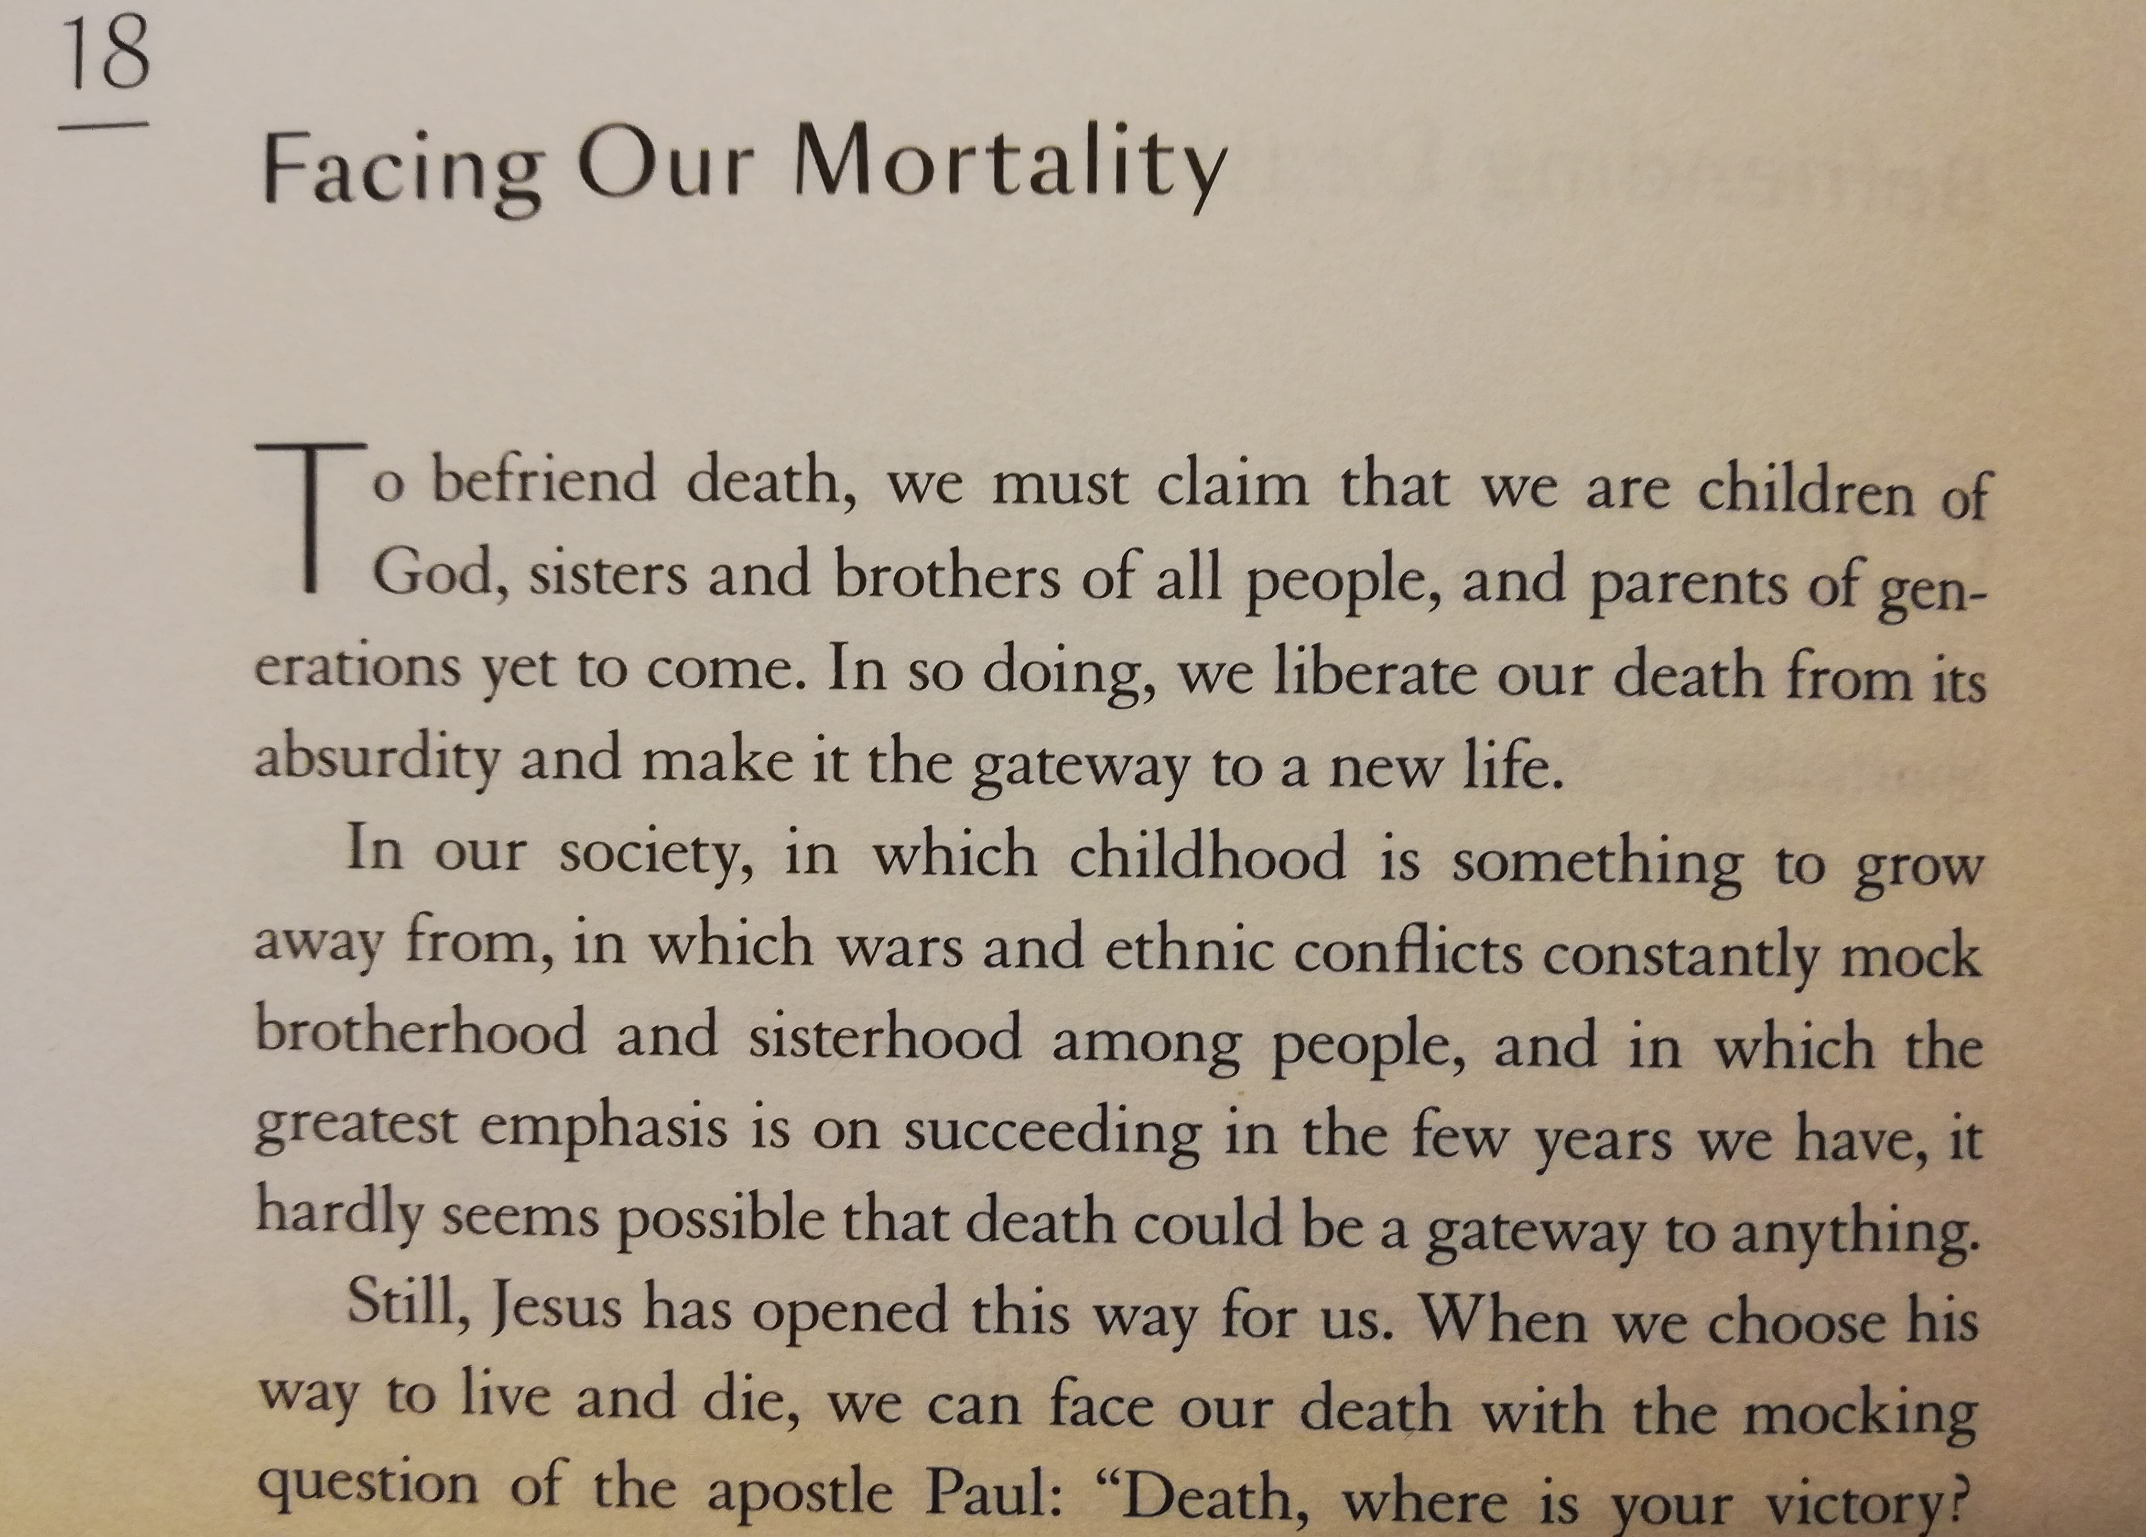
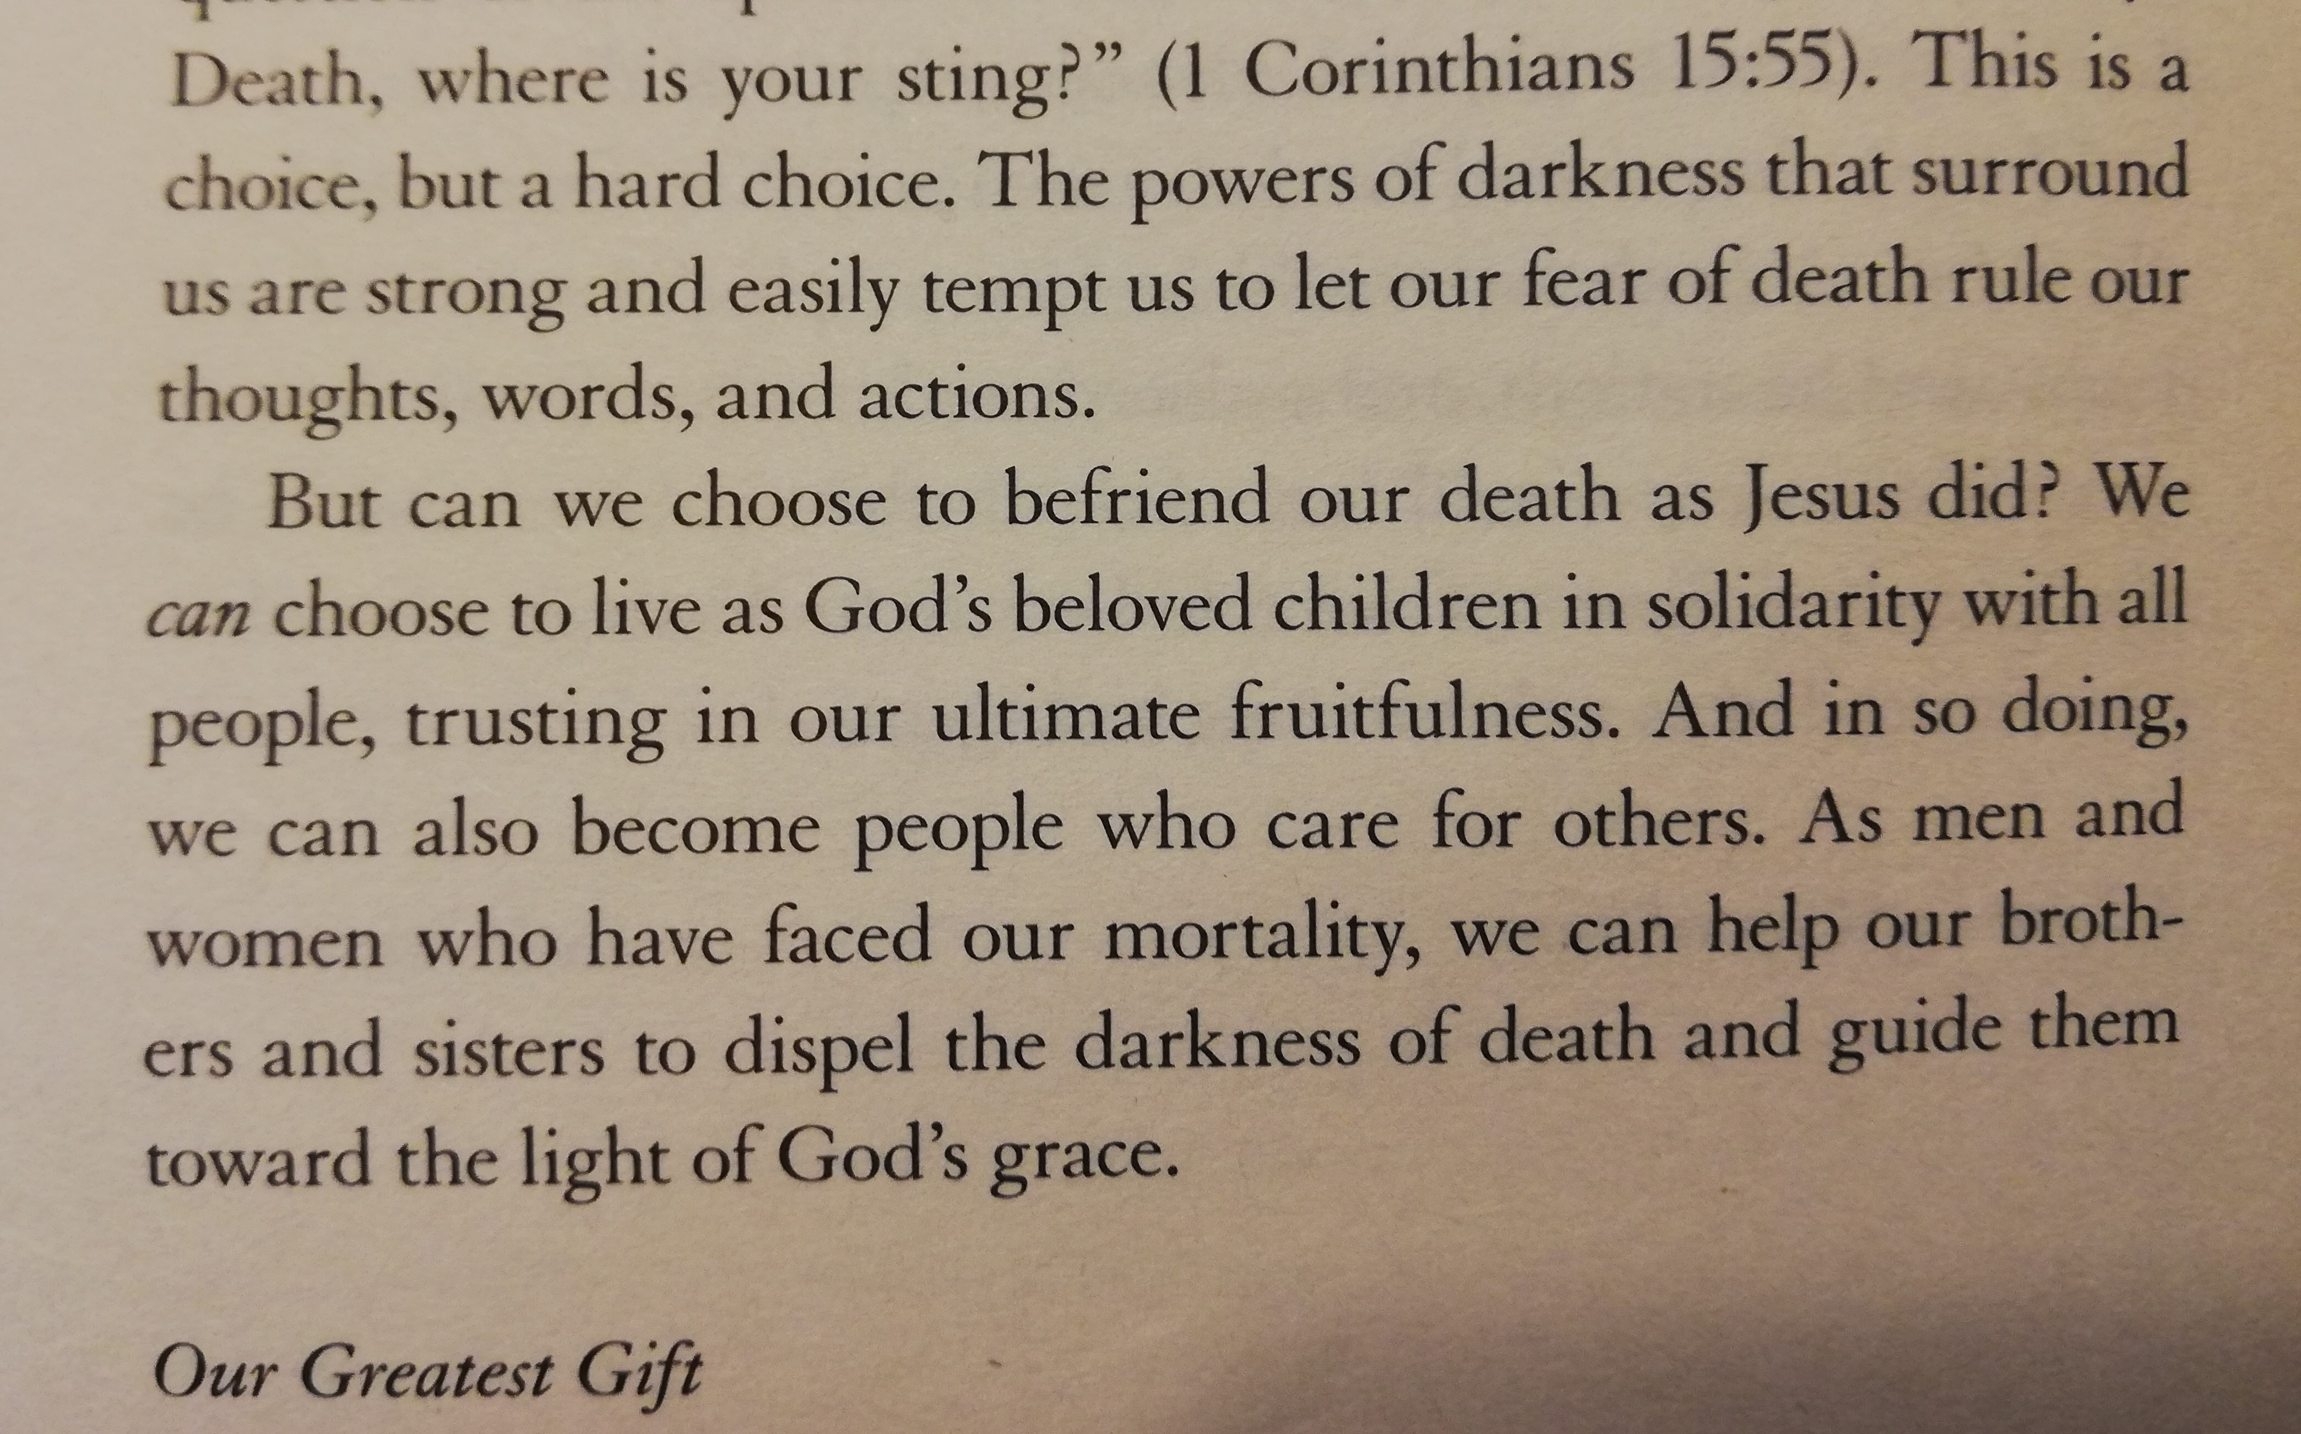

Slide 14
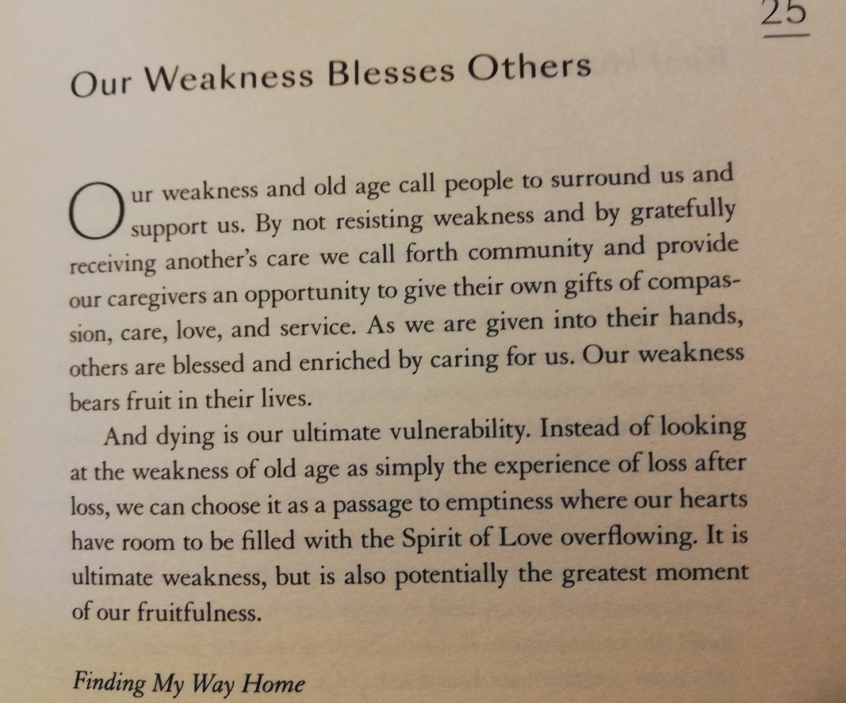

Slide 15
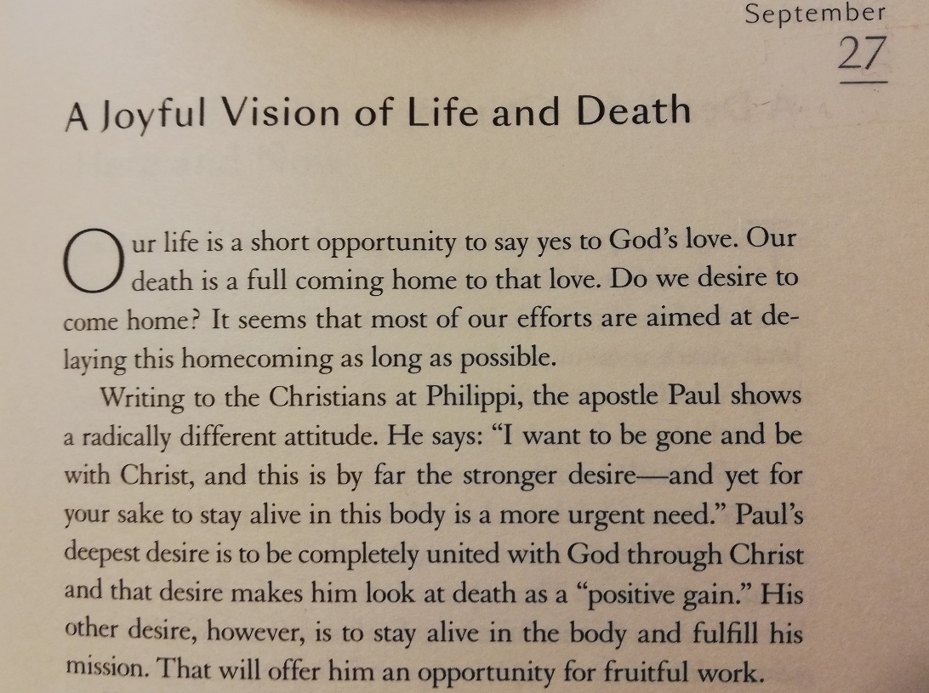
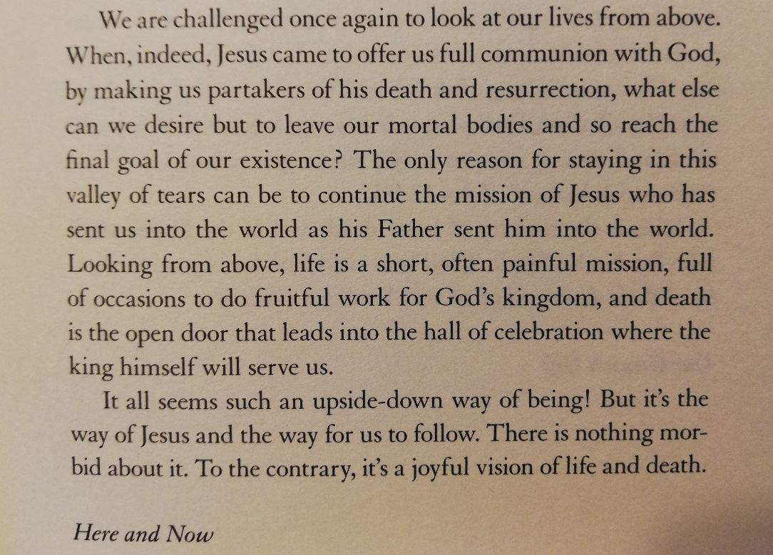
A Joyful Vision of Life and Death

Slide 17
Some practical suggestions . . .
ALWAYS carry some form of ID with you
Make your will
Appoint appropriate persons to hold Power of Welfare and Financial Attorney
Talk freely and openly with family and friends about dying and death
Eat, drink, enjoy life and thank God for His Gift of Life while it yet remains
Be at peace with God

