Slide 1
Paul’s 3rd Missionary Journey
Acts 18: 22 – 23
End of Missionary Journey 2
When he had landed at Caesarea he went up (south) to Jerusalem and
greeted the church and then went down (north) to Antioch.
Scotland:
To London, To Edinburgh
Palestine:
UP to Jerusalem, DOWN to Antioch

Slide 2
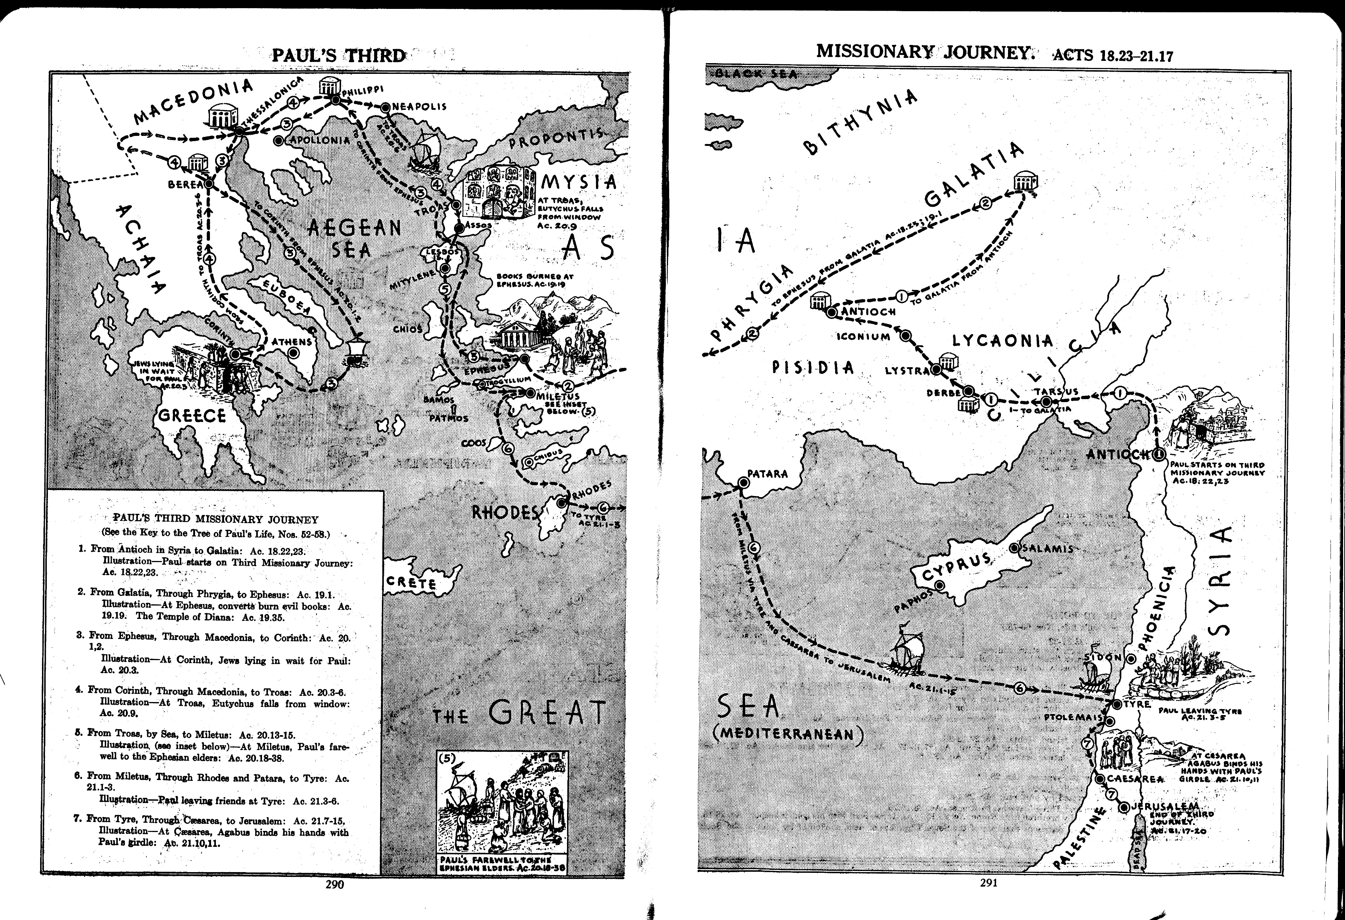
Paul’s 3rd Missionary Journey – the route
Approx 2800 miles, 4 years (~54 – 57 a.d.)
Emperor Nero: 54 – 68 a.d.

Slide 3
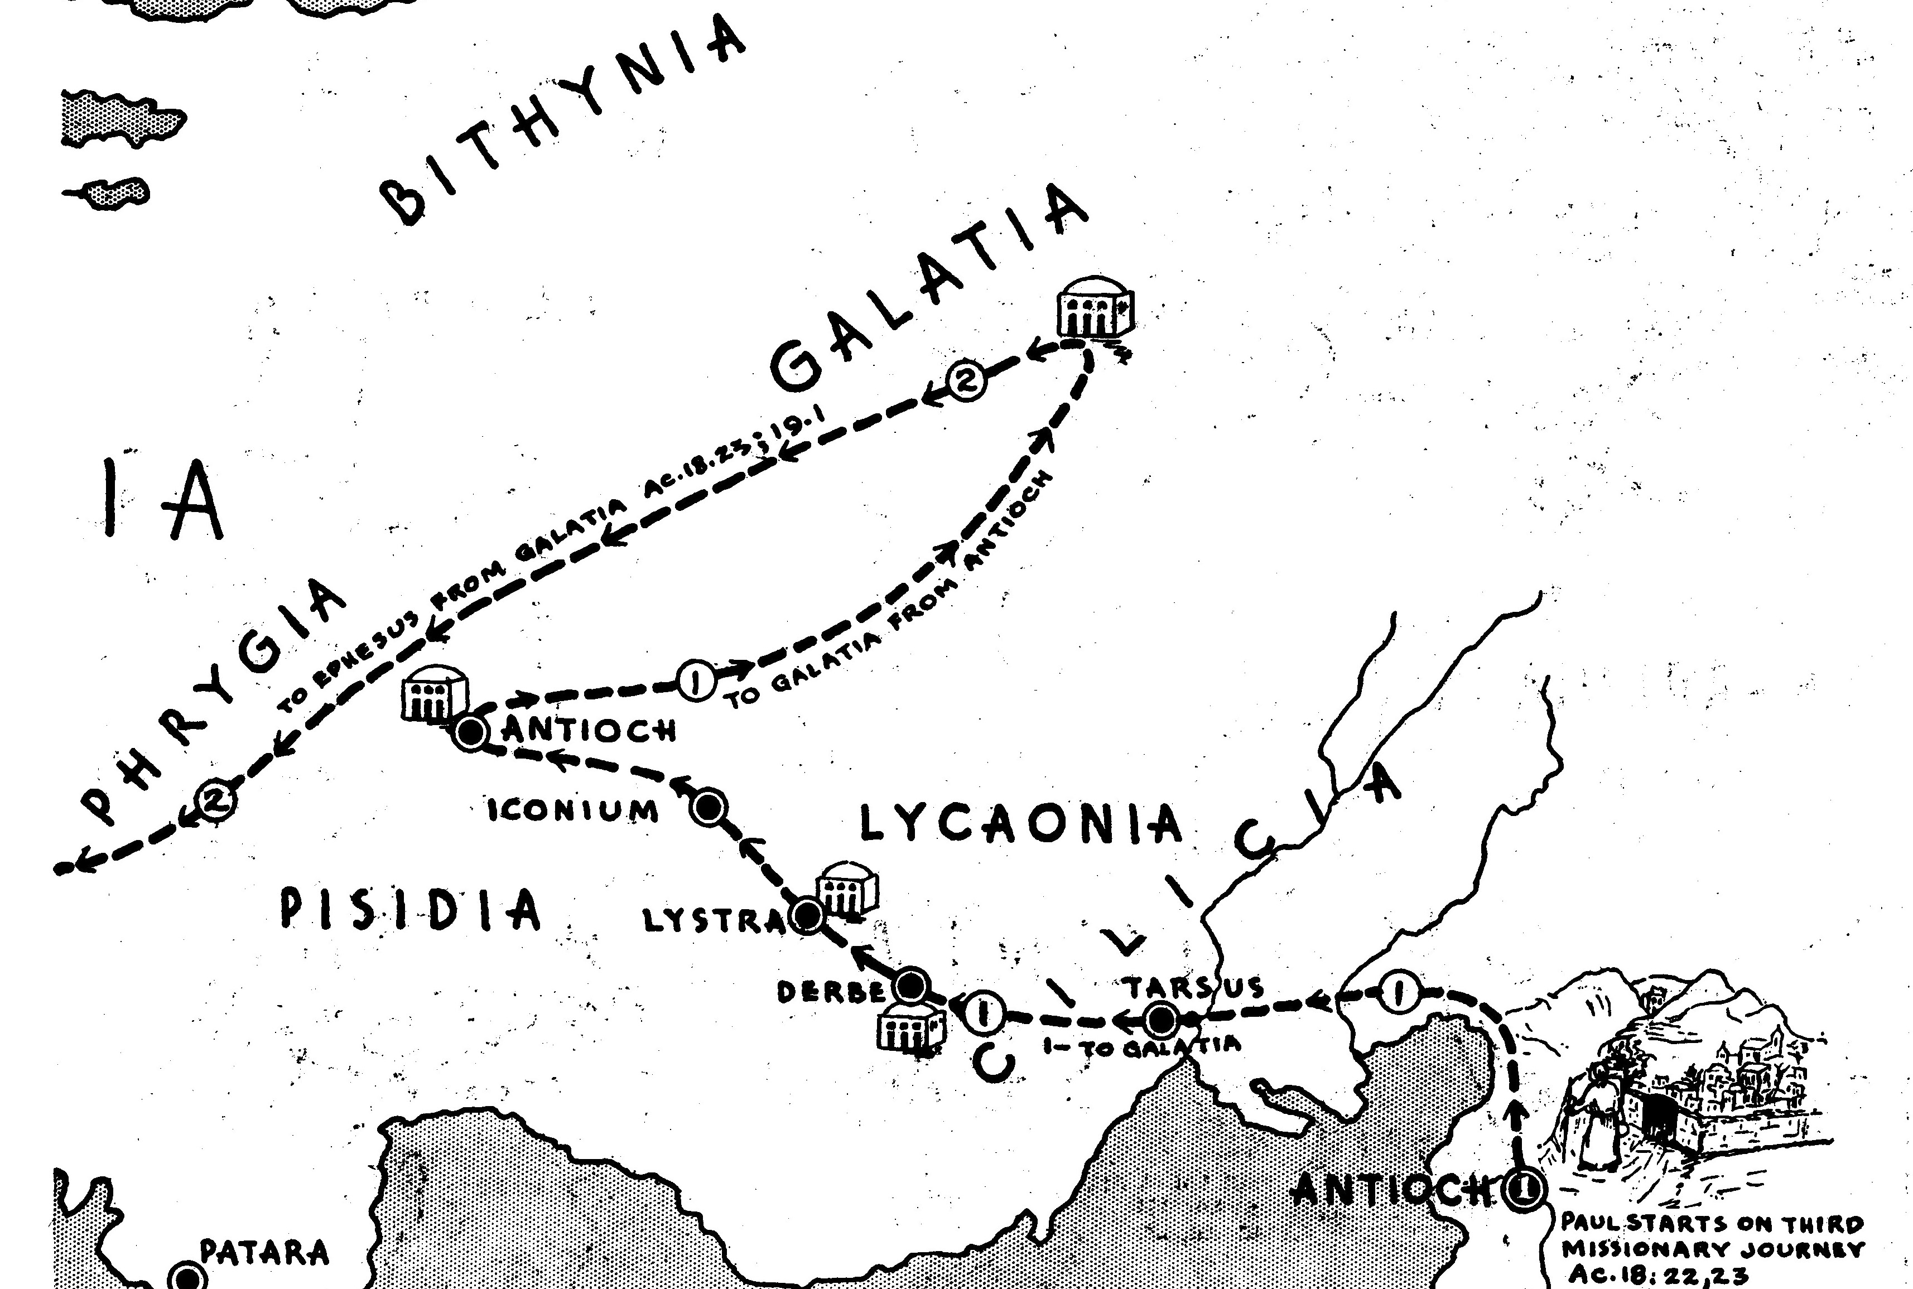
Paul’s 3rd Missionary Journey – the route
Acts 18:23 Start of 3rd Missionary Journey
. . . he departed and went from place to place through the region of Galatia and Phrygia, strengthening all the disciples (Main event)

Slide 4
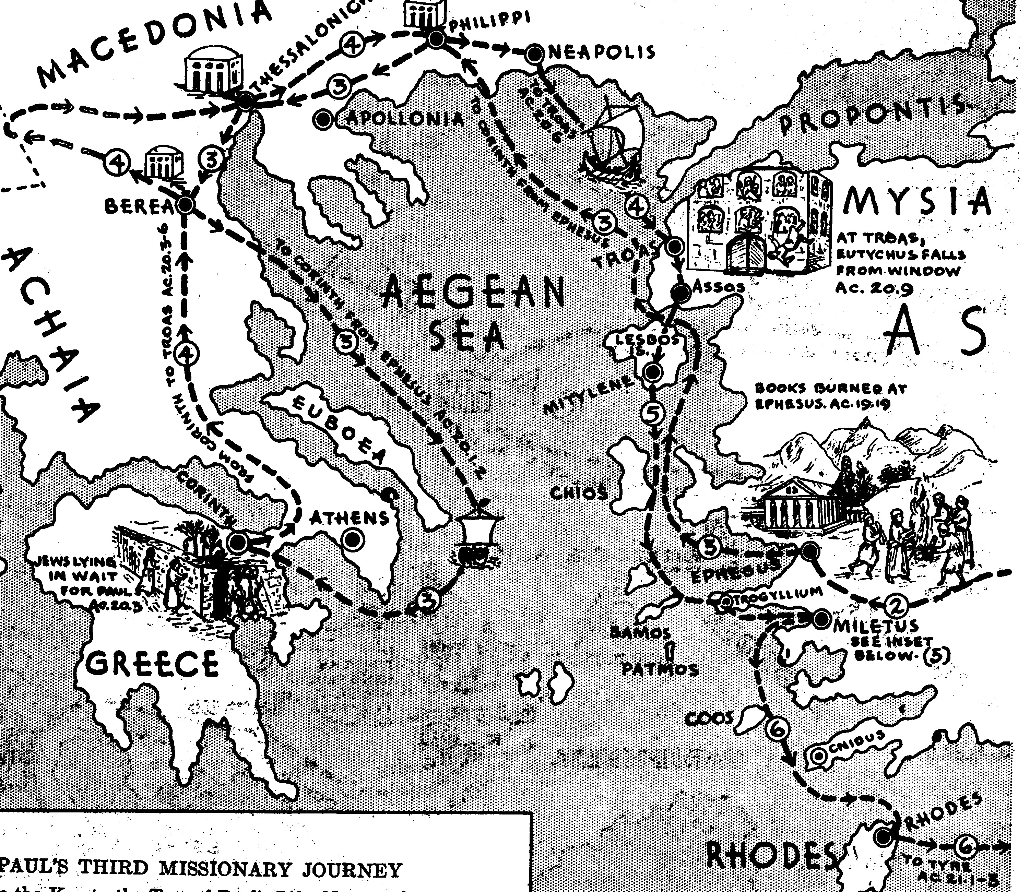
Paul’s 3rd Missionary Journey – the route
OUT
BACK
Acts 19:1 – 21:3 The rest of 3rd Missionary Journey

Slide 5
Paul’s 3rd Missionary Journey – Main Events
Ephesus: Tough time – Rioting
Macedonia: Encouraging believers (Did this include a visit to Illyricum??? -
Greece (Corinth): Stays 3 months - Titus went to Dalmatia (Illyricum) 2 Tim 4:10)
Travels Macedonia – Berea – Philippi – Troas
Troas: 7 days, long discussion, Eutychus event
Travels: Assos (alone) – Mitylene* – Chios – Samos – Miletus
Miletus: Home of a Jewish Community
Meets Elders from Ephesus
Sails: Miletus – Cos – Rhodes – Patara – Phoenicia – (Cyprus) – Tyre
Tyre: Meets disciples, stays 7 days
- - - - - - - End of 3rd Missionary Journey - - - - - - -
Ptolemais: Greets believers
Caesarea: Stays with Philip several days, meets Agabus
Travels: Heads for Jerusalem*
*Troas to Assos ~20 miles on a good Roman Road
*With Luke from Miletus to Jerusalem
*Sailing good in Spring through to Autumn, stormy in winter

Slide 6
Paul’s 3rd Missionary Journey – Companions
Galatia/Phrygia Strengthening believers Alone?
Ephesus: Tough time – Rioting Alone?
Macedonia: Encouraging believers ?
Greece (Corinth): Stays 3 months ?
Travels Macedonia – Berea – Philippi – Troas Sopater, Aristarchus, Secindus, Gaius,Timothy, Tychicus, Trophimus
Troas: Discussion, Eutychus event Luke
Travels: Assos Alone
Mitylene* – Chios – Samos – Miletus Luke + others
Miletus: Meets Elders from Ephesus Luke
Sails: Miletus to Tyre Luke
Tyre: Meets disciples, stays 7 days Luke + ?
- - - - - - - End of 3rd Missionary Journey - - - - - - -
Ptolemais: Greets believers Luke +
Caesarea: Stays with Philip Luke, Philip +
Travels: Heads for Jerusalem Luke +

Slide 7
Paul’s “unrecorded” journey
For I will not venture to speak of anything except what Christ has accomplished^{[a]} through me to win obedience from the Gentiles, by word and deed, ¹⁹ by the power of signs and wonders, by the power of the Spirit of God,^{[b]} so that from Jerusalem and as far around as Illyricum I have fully proclaimed the good news^{[c]} of Christ. ²⁰ Thus I make it my ambition to proclaim the good news,^{[d]} not where Christ has already been named, so that I do not build on someone else’s foundation, ²¹ but as it is written,
‘Those who have never been told of him shall see,
and those who have never heard of him shall understand.’
Romans 15: 18-21
For I will not venture to speak of anything except what Christ has accomplished^{[a]} through me to win obedience from the Gentiles, by word and deed, ¹⁹ by the power of signs and wonders, by the power of the Spirit of God,^{[b]} so that from Jerusalem and as far around as Illyricum I have fully proclaimed the good news^{[c]} of Christ. ²⁰ Thus I make it my ambition to proclaim the good news,^{[d]} not where Christ has already been named, so that I do not build on someone else’s foundation, ²¹ but as it is written,
‘Those who have never been told of him shall see,
and those who have never heard of him shall understand.’
… but where is Illyricum and (when) did Paul go there???

Slide 8
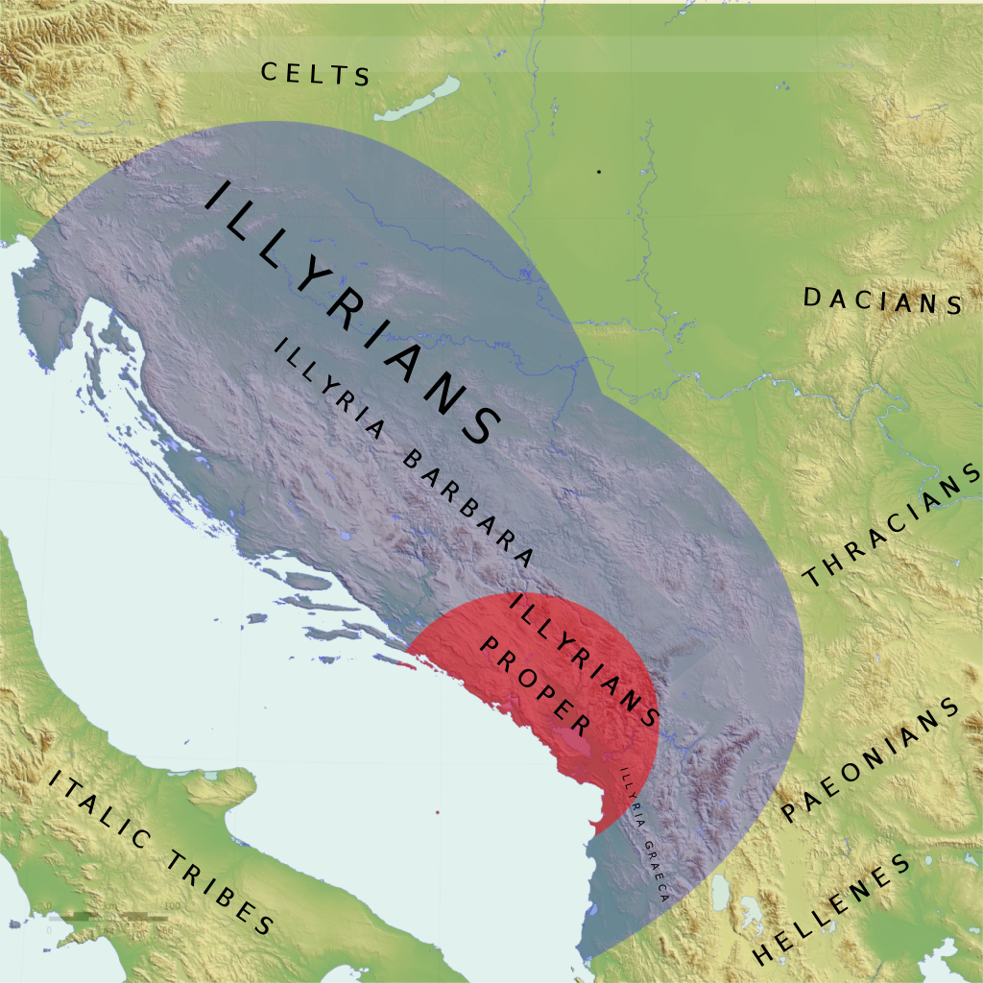
Paul’s “unrecorded” journey
For I will not venture to speak of anything except what Christ has accomplished^{[a]} through me to win obedience from the Gentiles, by word and deed, ¹⁹ by the power of signs and wonders, by the power of the Spirit of God,^{[b]} so that from Jerusalem and as far around as Illyricum I have fully proclaimed the good news^{[c]} of Christ. ²⁰ Thus I make it my ambition to proclaim the good news,[not where Christ has already been named, so that I do not build on someone else’s foundation, ²¹ but as it is written,
‘Those who have never been told of him shall see,
and those who have never heard of him shall understand.’
Romans 15 seems to imply that Paul went to Illyricum (now known as the regions of Croatia and Albania) before he went to Jerusalem (Romans 15:25-29; Acts 20) prior to his planned trip to Spain

