Slide 1
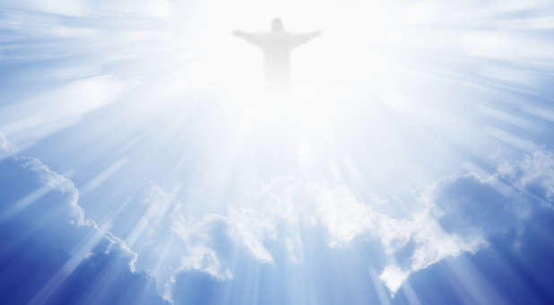
The Life of Jesus
Week 3 - March 20th 2021
LIGHT, POWER AND THE
SUPERNATURAL GOSPEL

Slide 2
John 1:9 . . . Two possible readings:
The true light, which enlightens everyone, was coming into the world. ("Jesus" is the subject of "coming")
He was the true light that enlightens everyone coming into the world.
("everyone" is the subject "coming")

Slide 3
John 1:12
He (the true Light) gave POWER to all who received him to become children of God
δύναμις (dynamite)
force (literally or figuratively);
miraculous power
ability, abundance, meaning, might,
power, strength, violence, mighty (wonderful) work.
ἐξουσία
power of choice
physical and/or mental ability
authority, right (privilege)
authority (in terms of government)

Slide 4
John 1:14
“And the Word became flesh and lived among us, and we have seen his GLORY, the glory as of a father’s only son, full of grace and truth”

Slide 6
Luke’s multi-decker sandwich (chapter 1)
1-5 Prologue
5-7 History (two main players introduced)
8-10 Zechariah and an angel
21-25 History (update on Zechariah and Elizabeth)
26-38 Mary and Gabriel
39-45 History (Mary goes to visit Elizabeth)
46-56 Mary’s song of praise
57-66 History (birth of John)
67-79 Zechariah’s prophecy

Slide 7
Zechariah and History
Adam 1 Chron 1, 2, 6:48, 24:10, Neh 12:1-8
Abraham
Isaac
Jacob/Israel
Judah …………………………………………………….Levi…………………….. (+ 10 more)
David Aaron Moses Others
. Priests Levites
. .
. .
. Abijah
. .
Mary … Joseph (Matthew) Zechariah = Elizabeth (Luke)
Jesus John

Slide 9
Luke and the Supernatural
8-10 Zechariah and the angel
26-38 Mary and Gabriel
46-56 Mary’s song of praise
67-79 Zechariah’s prophecy

Slide 10
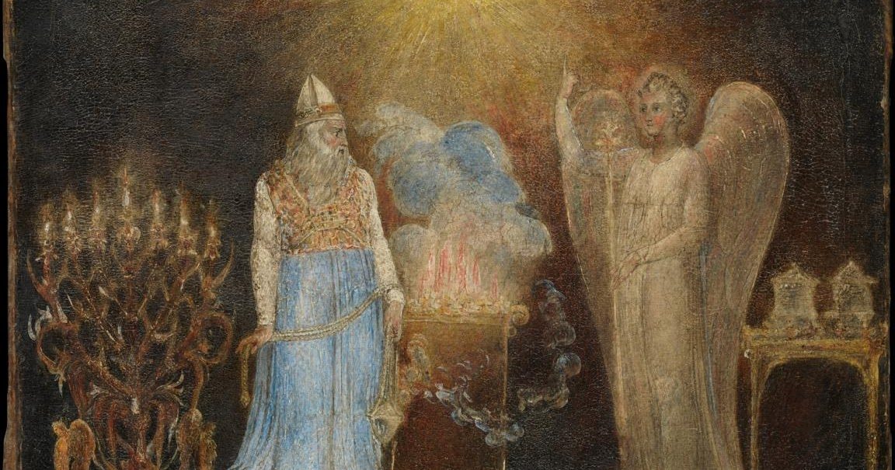
Luke and the Supernatural - Zechariah and the Angel

Slide 11
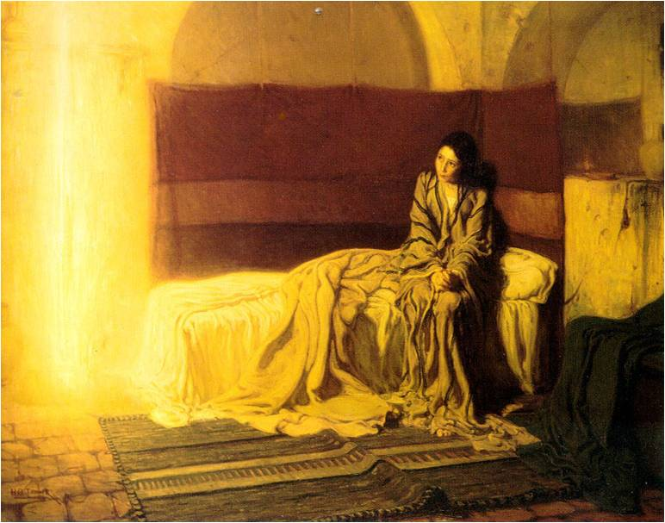
Luke and the Supernatural – Mary and Gabriel

Slide 12
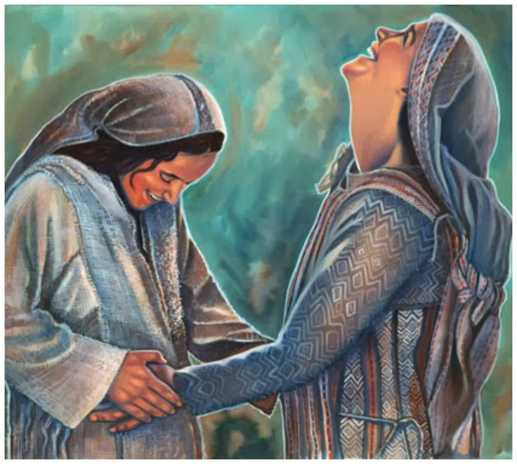
Mary’s response on meeting Elizabeth
Mary said,
“With all my heart I glorify the Lord!
In the depths of who I am I rejoice in God my saviour.
He has looked with favour on the low status of his servant.
Look! From now on, everyone will consider me
highly favoured because the mighty one has done
great things for me. Holy is his name. He shows mercy
to everyone, from one generation to the next,
who honours him as God. He has shown strength
with his arm. He has scattered those with arrogant
Thoughts and proud inclinations. He has pulled
the powerful down from their thrones and lifted
up the lowly. He has filled the hungry with
good things and sent the rich away empty-
handed. He has come to the aid of his servant
Israel, remembering his mercy, just as he promised
to our ancestors, to Abraham and to Abraham’s
descendants forever.”

Slide 13
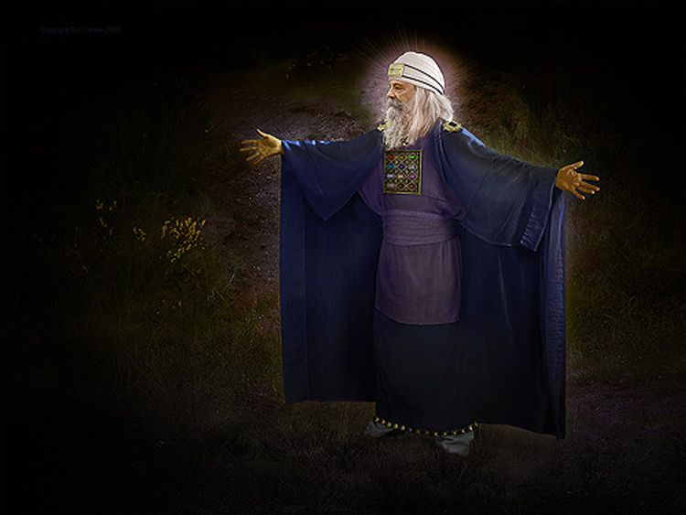
Luke and the Supernatural – Zechariah prophesies
Zechariah was filled with the Holy Spirit and gave this prophecy:
Praise the Lord, the God of Israel, because he has
visited and redeemed his people. He has sent us
a mighty Saviour from the royal line of his servant
David, just as he promised through his holy prophets
long ago. Now we will be saved from our enemies
and from all who hate us. He has been merciful to
our ancestors by remembering his sacred covenant
—the covenant he swore with an oath to our ancestor
Abraham. We have been rescued from our enemies
so we can serve God without fear, in holiness and righteousness for as long as we live. And you, my little son, will be called the prophet of the Most High, because you will prepare the way for the Lord. You will tell his people how to find salvation through forgiveness of their sins. Because of God’s tender mercy, the morning light from heaven is about to break upon us, to give light to those who sit in darkness and in the shadow of death, and to guide us to the path of peace.”

Slide 14
Supernatural events in Luke
“Angels, predictions, miracles are an intrinsic part of the gospel, because it concerns a supernatural breaking-in to our world, as unexpected as the message to Zechariah and as staggering as the one to Mary. For such supernaturalism we must be prepared: Christianity is meaningless without it”
.
“…Without the supernatural there is no gospel”
.
“If there is to be a salvation for humanity at all, it can be brought about only by the almighty, supernatural, miracle-working God. And he will offer it to people only through the medium of a first-century Jew – Jesus of Nazareth. This man alone, the central figure of Luke’s gospel, is to be the Saviour of the world”
- The Message of Luke, Michael Wilcock, Bible Speaks Today p.26

