Slide 1
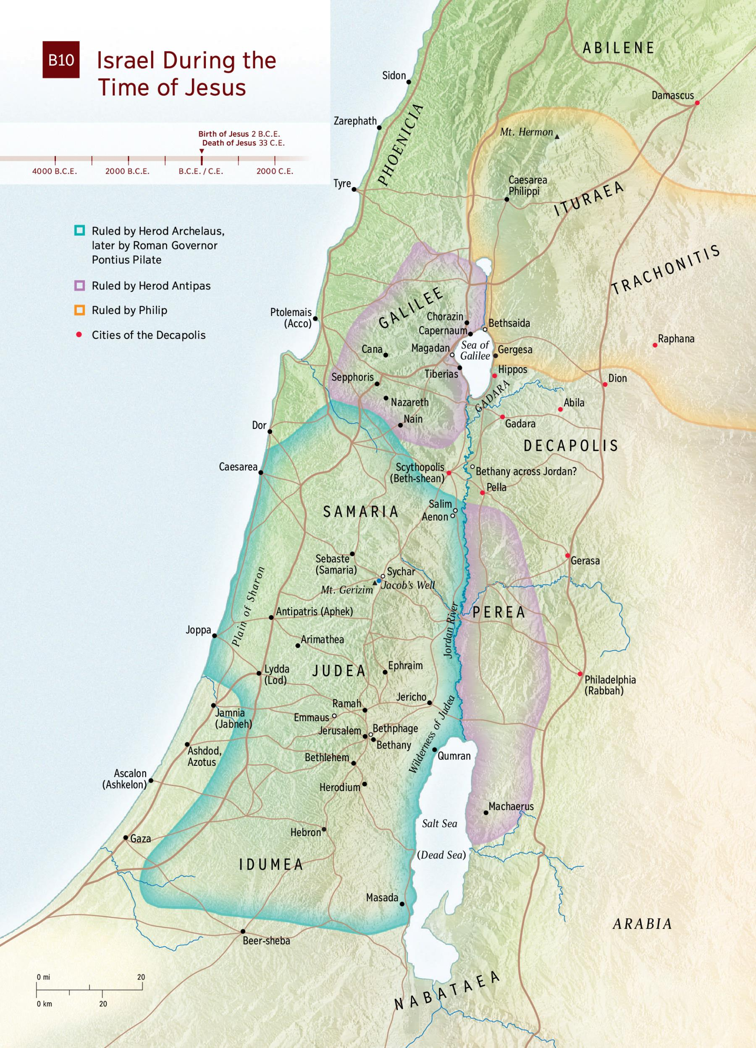
The Life of Christ - Week 13 - May 29th 2021 - John the Baptist
Ituraea - Philip
Galilee - Herod Antipas
Judea - Archelaus
- Pilate

Slide 2
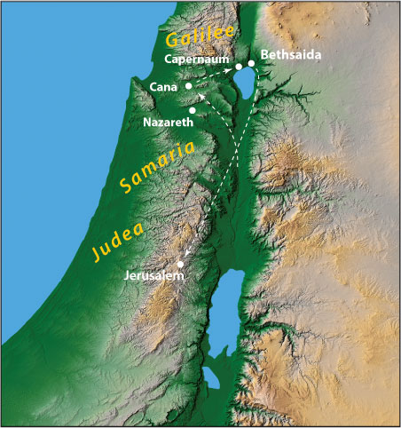
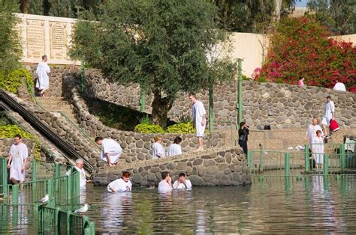
The Life of Christ - Week 13 - May 29th 2021 - John the Baptist
Aenon near Salim

Slide 3
The Life of Christ - Week 13 - May 29th 2021 - John the Baptist
Herod the anti-hero . . . but which Herod?
Herod the Great (73-4 b.c.)
Herod “Philip” Herod “Antipas” Philip Aristobulus Archelaus
(disinherited Tetrarch of Tetrarch of
by H/Gt) Galilee Ituraea
Lives in Rome (~20b.c. ~39a.d.) Herodias H. Agrippa 1
Married to Herodias Visits Rome, meets
Salome is Herodias’ Herodias, takes her
daughter to Galilee
Herods were descendants of Edomites
Meaning of Herod is uncertain. Perhaps related to fear/trembling or restless(ness)

Slide 4
The Life of Christ - Week 13 - May 29th 2021 - John the Baptist
Family Incest and Adultery
Herod the Great (73-4 b.c.)
Herod “Philip” Herod “Antipas” Philip Aristobulus Archelaus
(disinherited Tetrarch of Tetrarch of
by H/Gt) Galilee Ituraea
Lives in Rome (~20b.c. ~39a.d.) Herodias H. Agrippa 1
Married to Herodias Married to daughter of (Paul/Acts)
King Aretas (of Nabatean Arabs)
Visits Rome, meets
Salome is Herodias’ Herodias, takes her to Galilee
daughter by Philip
Antipas’ mother was a Samaritan
Antipas’ first wife is an Arabian Princess
Antipas marries Herodias (his niece and his sister-in-law)
Salome marries Philip (her uncle)
Herodias’ father, King Aretas, later goes to war and defeats Antipas in battle

Slide 5
The Life of Christ - Week 13 - May 29th 2021 - John the Baptist
Herod the anti-hero
Herod Antipas Herodias
Tetrarch of Galilee
Weak Imperious
Miserable Haughty
Cruel “Preferred a doubly adulterous and incestuous
Crafty marriage to Antipas than a life with the disinherited
Voluptuous Philip in Rome”
Violent
Dissolute tyrant “The people were scandalised”
Superstitious
Greatly distressed/perplexed
Enjoys listening to John (why??)
Wants to see Jesus
(happens at Jesus’ trial)
Eventually goes to Rome & emperor Caligula exiles him to Gaul
As described by Farrar, “The Life of Christ”, 272-281 & Hendriksen, NTC on Mark, 233-243

Slide 6
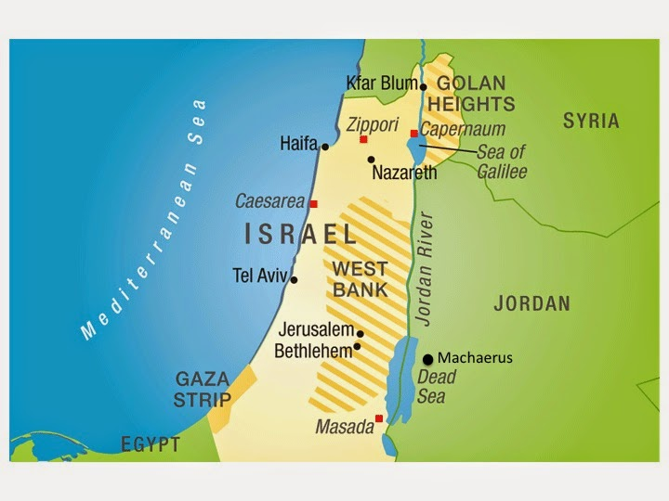
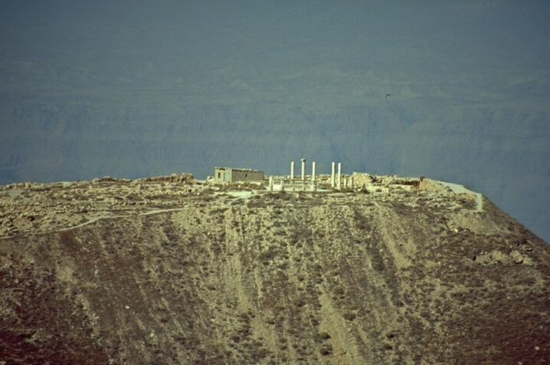
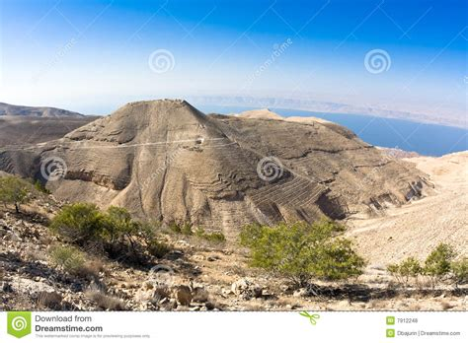
Castle at Machaerus

