Slide 1
The Life of Christ - Week 16 - June 19th
The Healing of the Royal Official’s son
The Storm on the Sea of Galilee
The Madman in the Decapolis

Slide 2
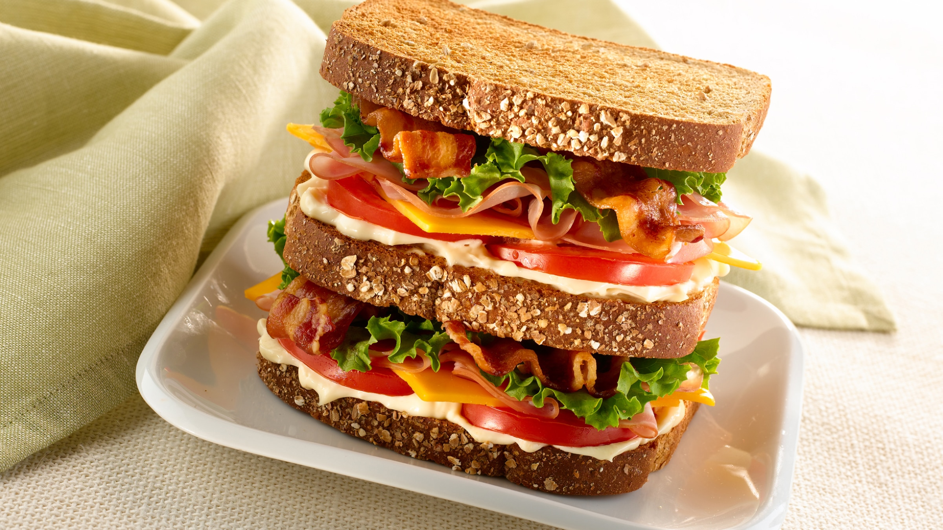
The Life of Christ - Week 16 - June 19th 2021 - A Storm and a Madman
b/f from last week:
The healing of the Nobleman/Royal/Government Official’s son
The “Markan sandwich” (Jairus daughter/Woman with haemorrhage)
“John’s triple decker”: John 3-4:
Jesus in Cana: Disciples believe (1st sign – water changed to wine)
filling 1: Nicodemus (Jewish theologian):
J&N talk -> N. believes
filling 2: Woman of Sychar (Samaritan):
J&W talk -> Woman & others believe
filling 3: Royal official (Gentile/Roman):
J&RO talk -> Household believes
Jesus in Cana: Official’s son healed (2nd Sign – saved from death)

Slide 3
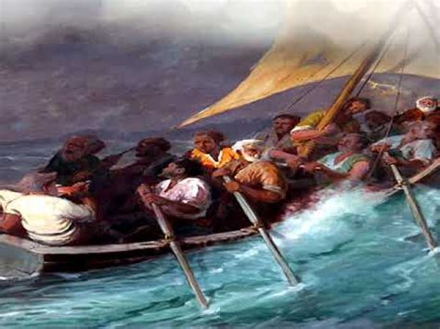
The Life of Christ - Week 16 - June 19th 2021 - A Storm and a Madman
The Storm

Slide 4
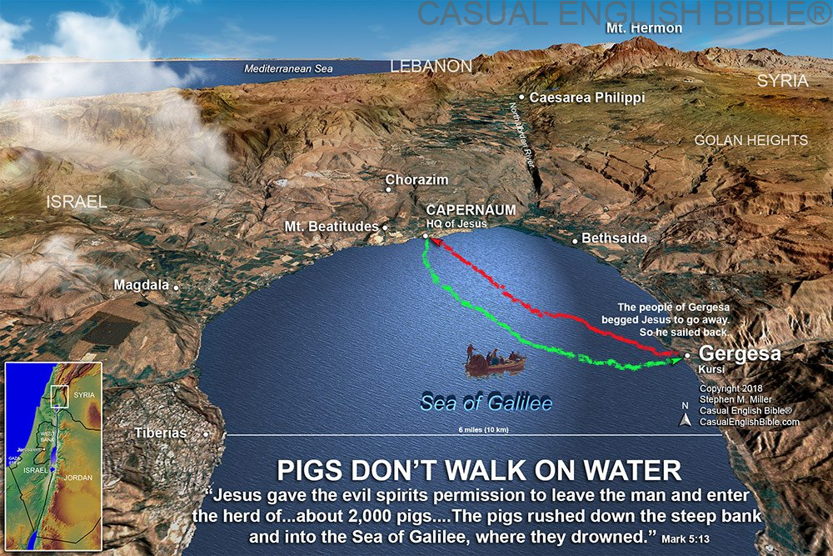
The Life of Christ - Week 16 - June 19th 2021 - A Storm and a Madman
Mt Hermon ~3000m } 3200m height difference
Galille ~ -200m }

Slide 5
The Life of Christ - Week 16 - June 19th 2021 - A Storm and a Madman
Job 30:22 (Job speaking) You lift me up on the wind, you make me ride on it, and you toss me about in the roar of the storm.
Ps 107: 23-32: Some went down to the sea in ships, doing business on the mighty waters; ²⁴ they saw the deeds of the Lord, his wondrous works in the deep. ²⁵ For he commanded and raised the stormy wind, which lifted up the waves of the sea. They mounted up to heaven, they went down to the depths; their courage melted away in their calamity; ²⁷ they reeled and staggered like drunkards, and were at their wits’ end. ²⁸ Then they cried to the Lord in their trouble, and he brought them out from their distress; he made the storm be still, and the waves of the sea were hushed. ³⁰ Then they were glad because they had quiet, and he brought them to their desired haven. ³¹ Let them thank the Lord for his steadfast love, for his wonderful works to humankind.
Ps 135: For I know that the Lord is great; our Lord is above all gods. ⁶ Whatever the Lord pleases he does, in heaven and on earth, in the seas and all deeps. ⁷ He it is who makes the clouds rise at the end of the earth; he makes lightnings for the rain and brings out the wind from his storehouses.

Slide 7
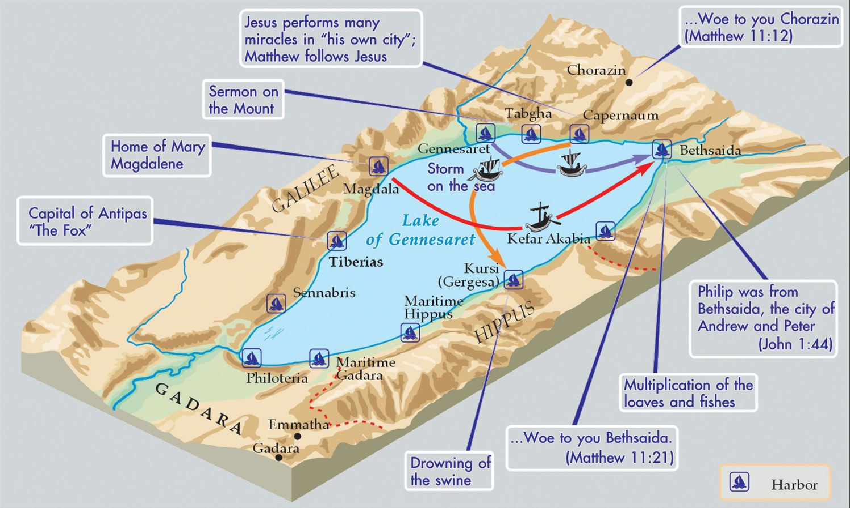
The Life of Christ - Week 16 - June 19th 2021 - A Storm and a Madman
N
S
“Many of the citizens of Gadara were rich men” – Josephus p.765
Gergesa. Cliffs/steep slopes into lake

Slide 8
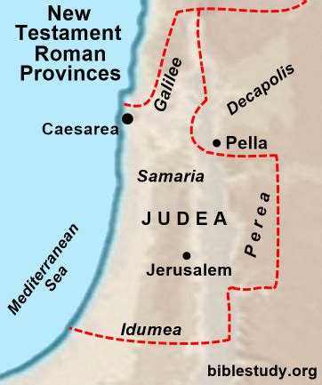
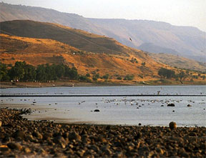
The Life of Christ - Week 16 - June 19th 2021 - A Storm and a Madman

Slide 9
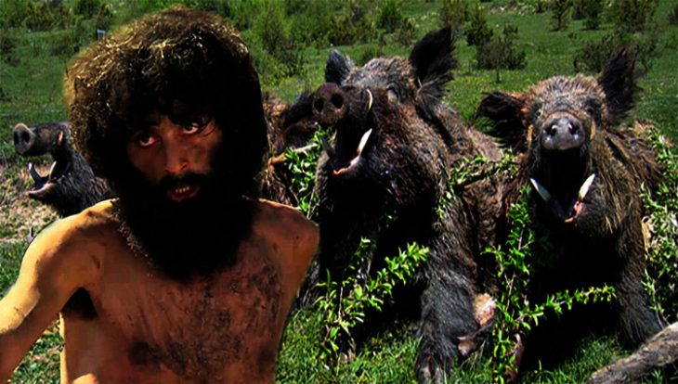
The Life of Christ - Week 16 - June 19th 2021 - A Storm and a Madman
The “Madman”

Slide 10
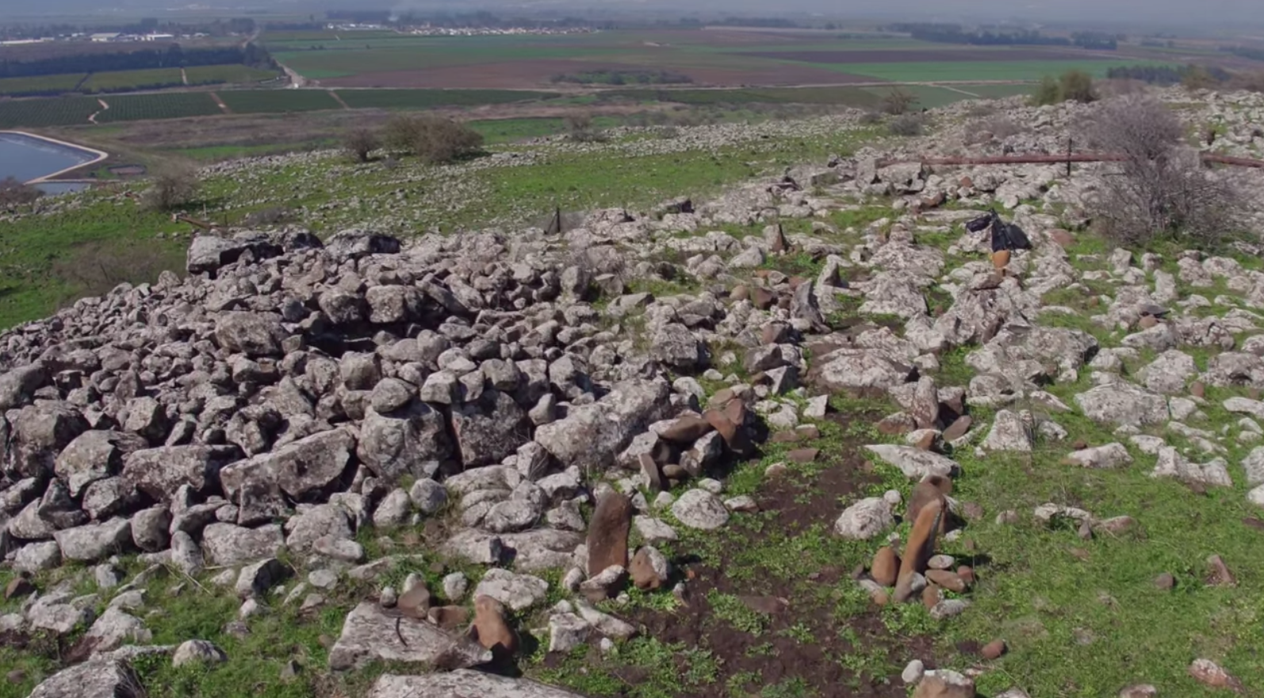
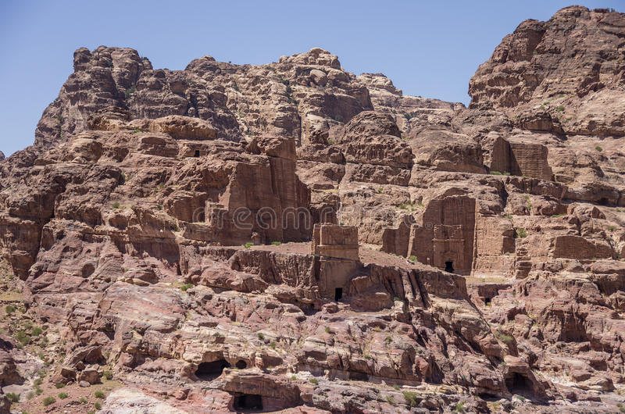
The Life of Christ - Week 16 - June 19th 2021 - A Storm and a Madman

