Slide 1
The Life of Christ - Week 22 - July 31st
The Sermon on the Mount (4)
“But I say . . .”

Slide 2
The Life of Christ - Week 22 - July 31st
The change of pronoun in Matthew 5
3-11: Blessed are the poor etc… THEY
13-14: Salt / Light YOU (Y’ALL)
21-end: Y’all have heard . . .
but I say . . . I

Slide 3
The Life of Christ - Week 22 - July 31st
Change of pronoun in Matthew 5
3-11: Blessed are the poor etc… THEY
13-14: Salt / Light YOU (Y’ALL)
21-end: Y’all have heard . . .
but I myself, I say . . . Emphatic I
7:29 “he taught them as one having authority, and not as the scribes”

Slide 5
The Life of Christ - Week 22 - July 31st
The 10 commandments
5. Not honouring parents
6. Murdering
7. Committing adultery
8. Theft
9. Being a false witness
10. Coveting
Which one is worst on your scale of evil?

Slide 6
The Life of Christ - Week 22 - July 31st
The 10 commandments
5. Honour parents
6. Murder
7. Adultery
8. Theft
9. False witness
10. Coveting
But I say . . .
-
Anger, retaliation
Adultery, Divorce
-
Oaths
-
+ Love and hate
+ Being perfect

Slide 7
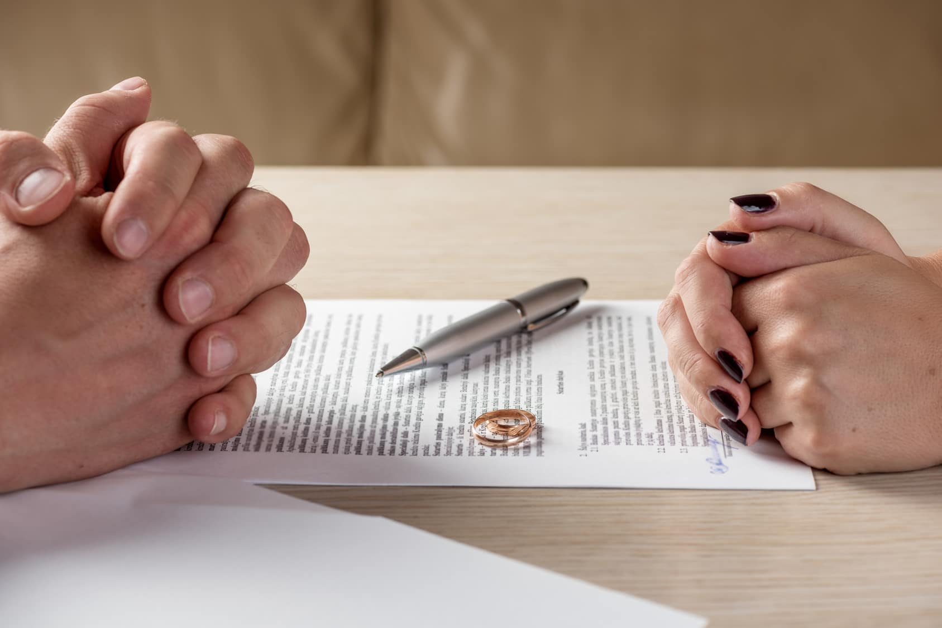



On Divorce

Slide 8
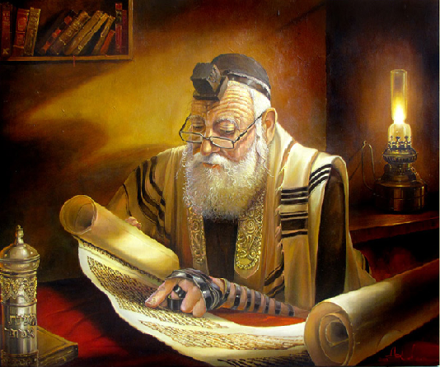
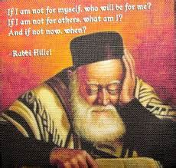
The Life of Christ - Week 22 - July 31st
Rabbi Hillel: (100bce – 20ce)
Sanhedrin president 20bce – 20ce
Liberal views
She burnt my dinner – I divorce her
Hillel’s views predominate in Jesus’ time
Rabbi Shammei (50bce – 30 ce).
Sanhedrin vice president 20 bce-20ce
Rigorist views
Divorce only for a “grave matrimonial offence”

Slide 9
The Life of Christ - Week 22 - July 31st
Divorce in Matt. 5 vs Divorce in Matt. 19
Context of the SoTM
It was said – “give a certificate”
I say: the only exception is unchastity. Beware: adultery probably follows.
No argument. No discussion
Context of Pharisee’s question to Jesus: Are you a Hillelite or a Shemmaiite?
In the beginning . . .
God’s act of union . . .
Hardness of heart
Divorce allowed by Moses
How to define an unsatisfactory wife???
I say: the only exception is unchastity. Beware: adultery probably follows .
No argument. No discussion

Slide 11
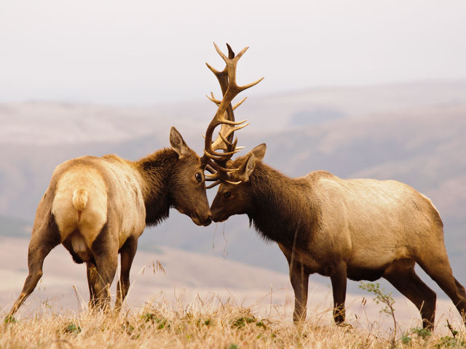
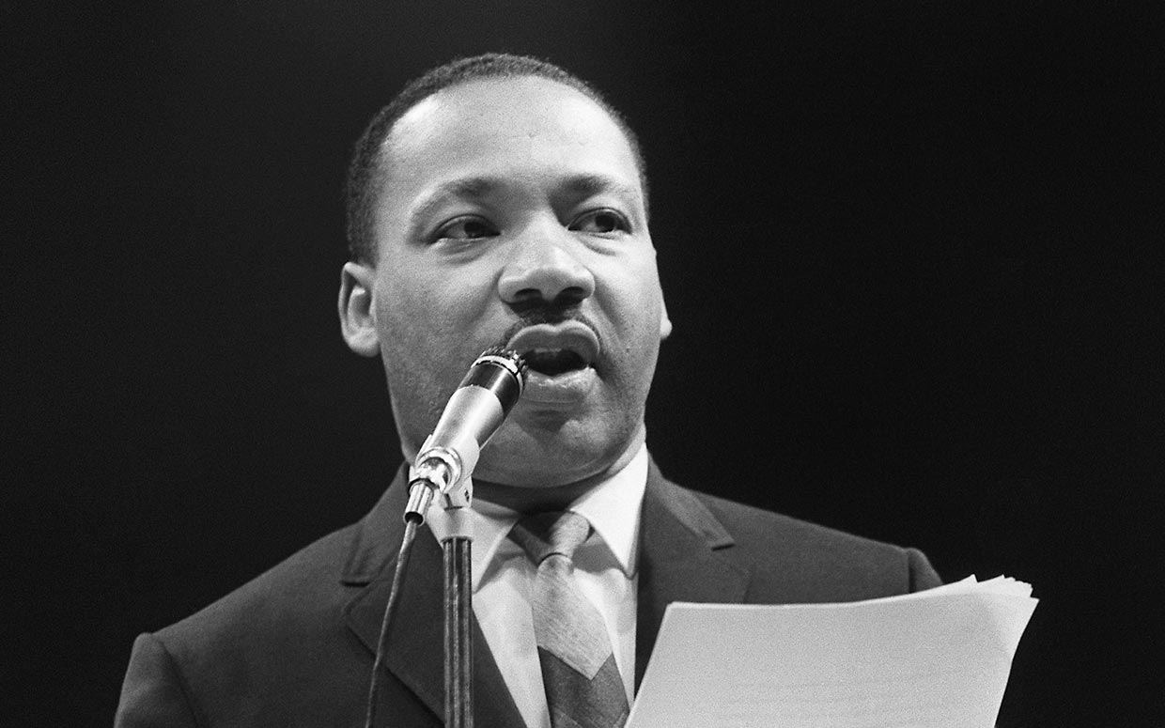
On Retaliation

Slide 12
The Life of Christ - Week 22 - July 31st
On Retaliation
In Egypt . . .
Just not possible
But I say . . .
Do not resist evil /an evildoer *
Turn the other cheek
Give your coat as well
Walk the extra mile
Give to the beggar
Don’t refuse a borrower
In early Israel . . .
Show no pity
life for life
eye for eye
tooth for tooth
hand for hand
foot for foot
(Ex 21:12-26, Deut 19:21)

Slide 13
The Life of Christ - Week 22 - July 31st
On Retaliation
Matt 5:39
Do not resist evil vs do not resist an evil person
BRG, DRA, GNV, HCSB, KJV, KJ21, NMB, RGT
ASV, AMP, CSB, CEB, CJB, CEV, DARBY, ERV, EHV, EXB, GW, GNT, ISV, LEB, MSG, MEV, NABRE, NASB, NCB, NCV, NET, NIV, NLT, NRSV, RSV, TLV

Slide 14
The Life of Christ - Week 22 - July 31st
On Retaliation
In Egypt . . .
Just not possible
But I say . . .
Do not resist evil /an evildoer *
Turn the other cheek
Give your coat as well
Walk the extra mile
Give to the beggar
Don’t refuse a borrower
Paul to the Romans:
Do not be overcome by evil but overcome evil with good. Rom 12:21
“Vengeance is mine, says the Lord” Rom 12:19
In early Israel . . .
Show no pity
life for life
eye for eye
tooth for tooth
hand for hand
foot for foot
(Ex 21:12-26, Deut 19:21)

Slide 15
The Life of Christ - Week 22 - July 31st
On Retaliation
“If any man knew the meaning of suffering, [Dr Martin Luther] King [Jn]knew. House bombed; living day by day for thirteen years under constant threats of death; maliciously accused of being a Communist; falsely accused of being insincere; stabbed by a member of his own race; slugged in a hotel lobby; jailed over twenty times; occasionally deeply hurt because friends had betrayed him – and yet this man had no bitterness of heart, no rancour in his soul, no revenge in his mind; and he went up and down the length and breadth of this world preaching non-violence and the redemptive power of love.”
John Stott quoting Dr Benjamin Mays on Martin Luther King.
Ref: Coretta Scott King, My life with Martin Luther King Jr, Hodder & Stoughton, 1970, pp365-369.

Slide 17
The Life of Christ - Week 22 - July 31st
“Be perfect, therefore, as your heavenly Father is perfect”
How do you think Jesus’ hearers reacted?
How do you react?

Slide 18
The Life of Christ - Week 22 - July 31st
“Be perfect, therefore, as your heavenly Father is perfect”
From Romans 7 – 8
For we know that the law is spiritual; but I am of the flesh, sold into slavery under sin. I do not understand my own actions. For I do not do what I want, but I do the very thing I hate. Now if I do what I do not want, I agree that the law is good. But in fact it is no longer I that do it, but sin that dwells within me. For I know that nothing good dwells within me, that is, in my flesh. I can will what is right, but I cannot do it. For I do not do the good I want, but the evil I do not want is what I do. Now if I do what I do not want, it is no longer I that do it, but sin that dwells within me. So I find it to be a law that when I want to do what is good, evil lies close at hand. For I delight in the law of God in my inmost self, but I see in my members another law at war with the law of my mind, making me captive to the law of sin that dwells in my members. Wretched man that I am! Who will rescue me from this body of death? Thanks be to God through Jesus Christ our Lord! So then, with my mind I am a slave to the law of God, but with my flesh I am a slave to the law of sin. 8. There is therefore now no condemnation for those who are in Christ Jesus. For the law of the Spirit of life in Christ Jesus has set you free from the law of sin and of death.

