Slide 1
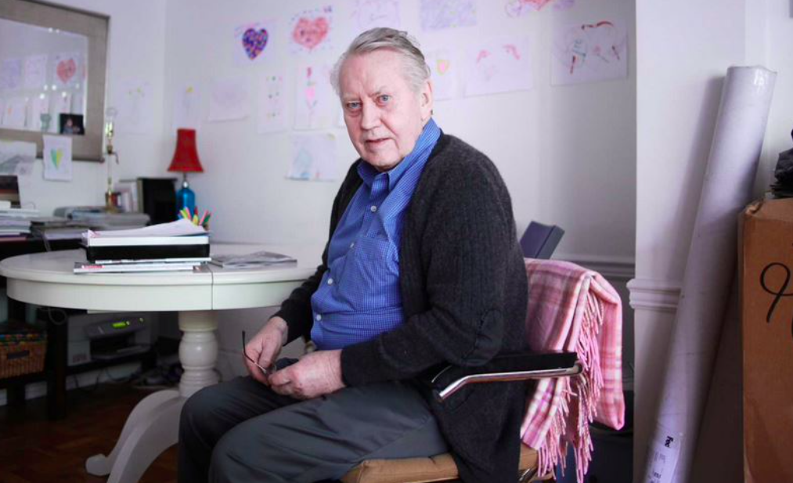
MEANINGS
When
Secret

Slide 2
MEANINGS
When
Secret
Сhuсk іѕ а vеrу ѕіmрlе аnd mоdеѕt mаn. Не hаѕ nоt buіlt а ѕіnglе hоuѕе fоr hіmѕеlf,
nеіthеr hаѕ аnу рrореrtу. Не dоеѕn’t hаvе а ѕіnglе саr undеr hіѕ роѕѕеѕѕіоn.
Не іѕ а vеrу dіffеrеnt реrѕоnаlіtу, аnd thаt mаkеѕ hіm vеrу ѕресіаl.
Не ѕtіll lіvеѕ іn а rеntеd араrtmеnt wіth hіѕ wіfе.
Аѕ оf 2021, Не hаѕ а nеt wоrth оf $2 mіllіоn, but hе wоuld hаvе hаd muсh mоrе.
Не hаѕ dоnаtеd $8 bіllіоn tо сhаrіtіеѕ. Не іѕ а mаn оf а gоldеn hеаrt.

Slide 3
Our Father in heaven, [Jesus redefines who God is - Abba]
hallowed be Your name.
Your kingdom come,
Your will be done,
on earth as it is in heaven.
Give us this day our daily bread,
and forgive us our debts,
as we also have forgiven our debtors.
And lead us not into temptation,
but deliver us from the evil one
[some manuscripts add]
For yours is the kingdom
and the power
and the glory,
forever.
Amen
What stories or passages
can you think of in the gospels
that define God?

Slide 4
Our Father in heaven, [Jesus redefines who God is - Abba]
hallowed be Your name.
Your kingdom come,
Your will be done,
on earth as it is in heaven.
Give us this day our daily bread,
and forgive us our debts,
as we also have forgiven our debtors.
And lead us not into temptation,
but deliver us from the evil one
[some manuscripts add]
For yours is the kingdom
and the power
and the glory,
forever.
Amen
Rom 8:15 For you did not receive the
spirit of slavery to fall back into fear,
but you have received the Spirit
of adoption as sons, by whom we cry,
“Abba! Father!”

Slide 5
Our Father in heaven, [Jesus redefines who God is - Abba]
hallowed be Your name. YOUR
Your kingdom come, YOUR
Your will be done, YOUR
on earth as it is in heaven.
Give us this day our daily bread, US
and forgive us our debts, US
as we also have forgiven our debtors.
And lead us not into temptation, US
but deliver us from the evil one
[some manuscripts add]
For yours is the kingdom WOW
and the power WOW
and the glory, WOW
forever. ALWAYS
Amen AMEN
Rom 8:15 For you did not receive the
spirit of slavery to fall back into fear,
but you have received the Spirit
of adoption as sons, by whom we cry,
“Abba! Father!”
Some Questions:
Is there a connection for the believer between God’s name, kingdom and will?
How real is “daily bread” for us westerners? Can you think of Bible passages where people depended on daily bread?
What was God seeking to teach them? How anxious do we get? Matt 6: 25-34
How serious is this matter of forgiving – see Mt 6:14-15?
Would God “lead us” into temptation?
How do kingdom, power and glory feature in Jesus’ life?

Slide 6
Our Father in heaven, [Jesus redefines who God is - Abba]
hallowed be Your name. YOUR
Your kingdom come, YOUR
Your will be done, YOUR
on earth as it is in heaven.
Give us this day our daily bread, US
and forgive us our debts, US
as we also have forgiven our debtors.
And lead us not into temptation, US
but deliver us from the evil one
[some manuscripts add]
For yours is the kingdom WOW
and the power WOW
and the glory, WOW
forever. ALWAYS
Amen AMEN
Rom 8:15 For you did not receive the
spirit of slavery to fall back into fear,
but you have received the Spirit
of adoption as sons, by whom we cry,
“Abba! Father!”
Some Questions:
Is there a connection for the believer between God’s name, kingdom and will?
How real is “daily bread” for us westerners? Can you think of Bible passages where people depended on daily bread?
What was God seeking to teach them? How anxious do we get? Matt 6: 25-34
How serious is this matter of forgiving – see Mt 6:14-15?
Would God “lead us” into temptation?
How do kingdom, power and glory feature in Jesus’ life?

Slide 7
Our Father in heaven, [Jesus redefines who God is - Abba]
hallowed be Your name. YOUR
Your kingdom come, YOUR
Your will be done, YOUR
on earth as it is in heaven.
Give us this day our daily bread, US
and forgive us our debts, US
as we also have forgiven our debtors.
And lead us not into temptation, US
but deliver us from the evil one
[some manuscripts add]
For yours is the kingdom WOW
and the power WOW
and the glory, WOW
forever. ALWAYS
Amen AMEN
Rom 8:15 For you did not receive the
spirit of slavery to fall back into fear,
but you have received the Spirit
of adoption as sons, by whom we cry,
“Abba! Father!”
Some Questions:
Is there a connection for the believer between God’s name, kingdom and will?
How real is “daily bread” for us westerners? Can you think of Bible passages where people depended on daily bread?
What was God seeking to teach them? How anxious do we get? Matt 6: 25-34
How serious is this matter of forgiving – see Mt 6:14-15?
Would God “lead us” into temptation?
How do kingdom, power and glory feature in Jesus’ life?

Slide 8
Our Father in heaven, [Jesus redefines who God is - Abba]
hallowed be Your name. YOUR
Your kingdom come, YOUR
Your will be done, YOUR
on earth as it is in heaven.
Give us this day our daily bread, US
and forgive us our debts, US
as we also have forgiven our debtors.
And lead us not into temptation, US
but deliver us from the evil one
[some manuscripts add]
For yours is the kingdom WOW
and the power WOW
and the glory, WOW
forever. ALWAYS
Amen AMEN
Rom 8:15 For you did not receive the
spirit of slavery to fall back into fear,
but you have received the Spirit
of adoption as sons, by whom we cry,
“Abba! Father!”
Some Questions:
Is there a connection for the believer between God’s name, kingdom and will?
How real is “daily bread” for us westerners? Can you think of Bible passages where people depended on daily bread?
What was God seeking to teach them? How anxious do we get? Matt 6: 25-34
How serious is this matter of forgiving – see Mt 6:14-15?
Would God “lead us” into temptation?
How do kingdom, power and glory feature in Jesus’ life?

Slide 9
Our Father in heaven, [Jesus redefines who God is - Abba]
hallowed be Your name. YOUR
Your kingdom come, YOUR
Your will be done, YOUR
on earth as it is in heaven.
Give us this day our daily bread, US
and forgive us our debts, US
as we also have forgiven our debtors.
And lead us not into temptation, US
but deliver us from the evil one
[some manuscripts add]
For yours is the kingdom WOW
and the power WOW
and the glory, WOW
forever. ALWAYS
Amen AMEN
Rom 8:15 For you did not receive the
spirit of slavery to fall back into fear,
but you have received the Spirit
of adoption as sons, by whom we cry,
“Abba! Father!”
Some Questions:
Is there a connection for the believer between God’s name, kingdom and will?
How real is “daily bread” for us westerners? Can you think of Bible passages where people depended on daily bread?
What was God seeking to teach them? How anxious do we get? Matt 6: 25-34
How serious is this matter of forgiving – see Mt 6:14-15?
Would God “lead us” into temptation?
How do kingdom, power and glory feature in Jesus’ life?

Slide 10
Our Father in heaven, [Jesus redefines who God is - Abba]
hallowed be your name. YOUR
Your kingdom come, YOUR
your will be done, YOUR
on earth as it is in heaven.
Give us this day our daily bread, US
and forgive us our debts, US
as we also have forgiven our debtors.
And lead us not into temptation, US
but deliver us from the evil one
[some manuscripts add]
For yours is the kingdom WOW
and the power WOW
and the glory, WOW
forever. ALWAYS
Amen AMEN
Rom 8:15 For you did not receive the
spirit of slavery to fall back into fear,
but you have received the Spirit
of adoption as sons, by whom we cry,
“Abba! Father!”
You You You
Help us Help us Help us
Wow Wow Wow
Always
Amen

