Slide 1
Matthew 8
Jesus Heals Many at Peter’s House
When Jesus entered Peter’s house, he saw his mother-in-law lying in bed with a fever; he touched her hand, and the fever left her, and she got up and began to serve him. That evening they brought to him many who were possessed by demons; and he cast out the spirits with a word, and cured all who were sick. This was to fulfil what had been spoken through the prophet Isaiah, ‘He took our infirmities and bore our diseases.’
Would-Be Followers of Jesus
Now when Jesus saw great crowds around him, he gave orders to go over to the other side. A scribe then approached and said, ‘Teacher, I will follow you wherever you go.’ And Jesus said to him, ‘Foxes have holes, and birds of the air have nests; but the Son of Man has nowhere to lay his head.’ Another of his disciples said to him, ‘Lord, first let me go and bury my father.’ But Jesus said to him, ‘Follow me, and let the dead bury their own dead.’
Jesus Stills the Storm
And when he got into the boat, his disciples followed him. A gale arose on the lake, so great that the boat was being swamped by the waves; but he was asleep. And they went and woke him up, saying, ‘Lord, save us! We are perishing!’ And he said to them, ‘Why are you afraid, you of little faith?’ Then he got up and rebuked the winds and the sea; and there was a dead calm. They were amazed, saying, ‘What sort of man is this, that even the winds and the sea obey him?’

Slide 2
Luke 9
A Samaritan Village Refuses to Receive Jesus
When the days drew near for him to be taken up, he set his face to go to Jerusalem. And he sent messengers ahead of him. On their way they entered a village of the Samaritans to make ready for him; but they did not receive him, because his face was set towards Jerusalem. When his disciples James and John saw it, they said, ‘Lord, do you want us to command fire to come down from heaven and consume them?’ But he turned and rebuked them. Then they went on to another village.
Would-Be Followers of Jesus
As they were going along the road, someone said to him, ‘I will follow you wherever you go.’ And Jesus said to him, ‘Foxes have holes, and birds of the air have nests; but the Son of Man has nowhere to lay his head.’ To another he said, ‘Follow me.’ But he said, ‘Lord, first let me go and bury my father.’ But Jesus said to him, ‘Let the dead bury their own dead; but as for you, go and proclaim the kingdom of God.’ Another said, ‘I will follow you, Lord; but let me first say farewell to those at my home.’ Jesus said to him, ‘No one who puts a hand to the plough and looks back is fit for the kingdom of God.’
Luke 10: The Mission of the Seventy
After this the Lord appointed seventy others….

Slide 3
Luke 9
Would-Be Followers of Jesus
…Jesus said to him, ‘No one who puts a hand to the plough and looks back is fit for the kingdom of God.’
Luke 10: The Mission of the Seventy
After this the Lord appointed seventy others and sent them on ahead of him in pairs to every town and place where he himself intended to go. He said to them, ‘The harvest is plentiful, but the labourers are few; therefore ask the Lord of the harvest to send out labourers into his harvest. Go on your way. See, I am sending you out like lambs into the midst of wolves. Carry no purse, no bag, no sandals; and greet no one on the road. Whatever house you enter, first say, “Peace to this house!” And if anyone is there who shares in peace, your peace will rest on that person; but if not, it will return to you. Remain in the same house, eating and drinking whatever they provide, for the labourer deserves to be paid. Do not move about from house to house. Whenever you enter a town and its people welcome you, eat what is set before you; cure the sick who are there, and say to them, “The kingdom of God has come near to you.” But whenever you enter a town and they do not welcome you, go out into its streets and say, “Even the dust of your town that clings to our feet, we wipe off in protest against you. Yet know this: the kingdom of God has come near.” I tell you, on that day it will be more tolerable for Sodom than for that town.

Slide 4
Other (related?) texts…

Slide 5
Luke 14:25-33
The Cost of Discipleship
Now large crowds were travelling with him; and he turned and said to them, ‘Whoever comes to me and does not hate father and mother, wife and children, brothers and sisters, yes, and even life itself, cannot be my disciple. Whoever does not carry the cross and follow me cannot be my disciple. For which of you, intending to build a tower, does not first sit down and estimate the cost, to see whether he has enough to complete it? Otherwise, when he has laid a foundation and is not able to finish, all who see it will begin to ridicule him, saying, “This fellow began to build and was not able to finish.” Or what king, going out to wage war against another king, will not sit down first and consider whether he is able with ten thousand to oppose the one who comes against him with twenty thousand? If he cannot, then, while the other is still far away, he sends a delegation and asks for the terms of peace. So therefore, none of you can become my disciple if you do not give up all your possessions.

Slide 6
Luke 9:21-27
Jesus Foretells His Death and Resurrection
He sternly ordered and commanded them not to tell anyone, saying, ‘The Son of Man must undergo great suffering, and be rejected by the elders, chief priests, and scribes, and be killed, and on the third day be raised.’
Then he said to them all, ‘If any want to become my followers, let them deny themselves and take up their cross daily and follow me. For those who want to save their life will lose it, and those who lose their life for my sake will save it. What does it profit them if they gain the whole world, but lose or forfeit themselves? Those who are ashamed of me and of my words, of them the Son of Man will be ashamed when he comes in his glory and the glory of the Father and of the holy angels. But truly I tell you, there are some standing here who will not taste death before they see the kingdom of God.’

Slide 7
Luke 14:26
If anyone comes to me and does not hate his own father and mother and wife and children and brothers and sisters, yes, and even his own life, he cannot be my disciple.
Luke 14:33
So therefore, any one of you who does not renounce all that he has cannot be my disciple.
John 12:25
Whoever loves his life loses it, and whoever hates his life in this world will keep it for eternal life.

Slide 8
Urgency? or
Self-denial as a moral good?

Slide 9
EGW – urgency?
https://www.ministrymagazine.org/archive/1988/02/have-we-delayed-the-advent
https://www.crcbermuda.com/reference2/ellen-white-topics/the-urgency-of-evangelism

Slide 10
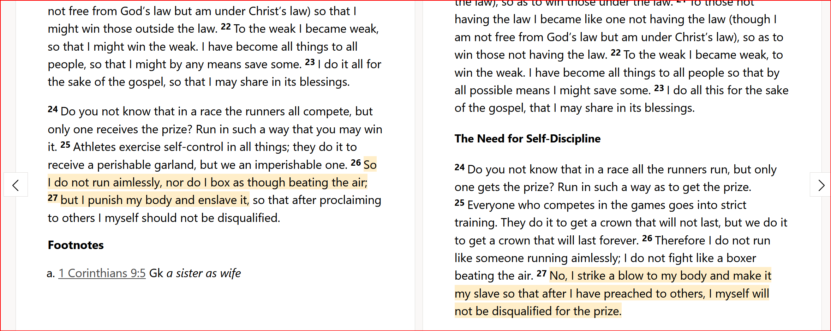
1Cor 9 – self denial as a moral good?
NRSV
NIV
Ref - Opus Dei
https://www.religionnewsblog.com/11810/an-opus-dei-priest-defends-self-punishment-of-the-body

Slide 11
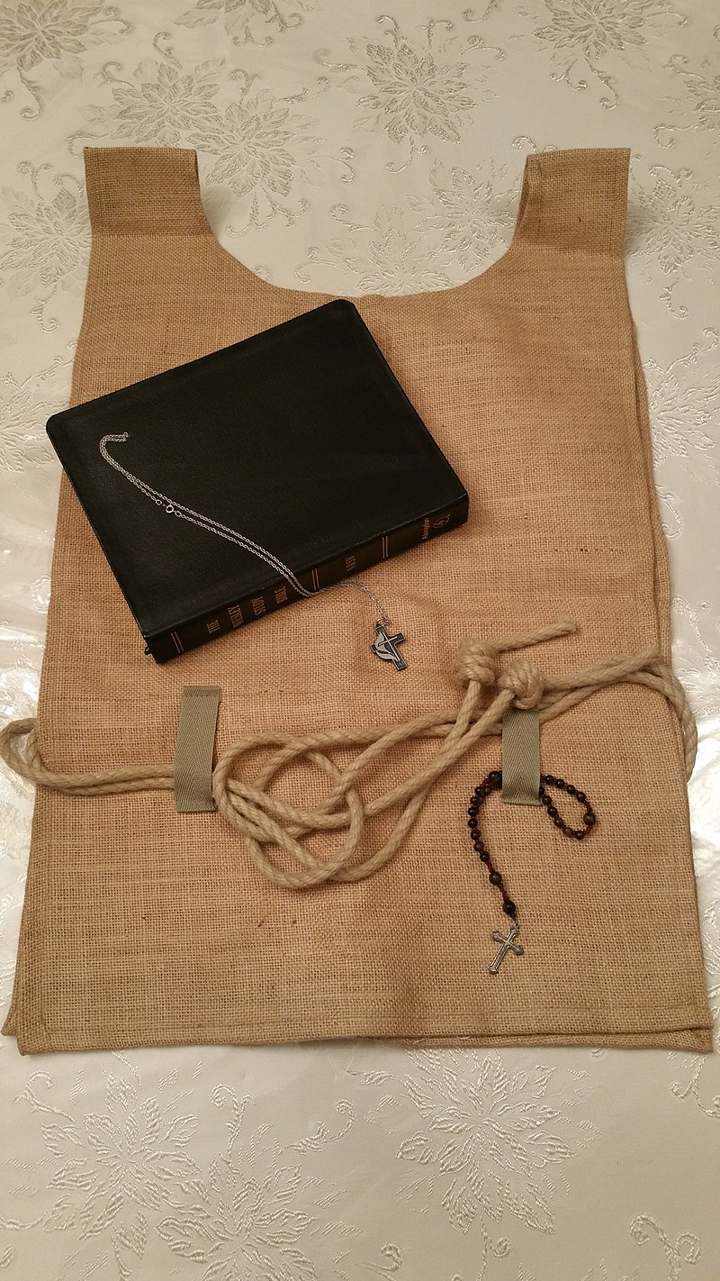
Cilice hair shirt

Slide 12
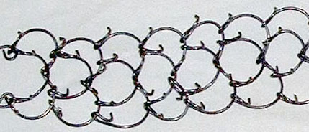
Cilice metal spikes warn around the leg

