Slide 1
Jesus’ Ascension
The Four Stages of Salvation
Incarnation
Crucifixion
Resurrection
Ascension

Slide 2
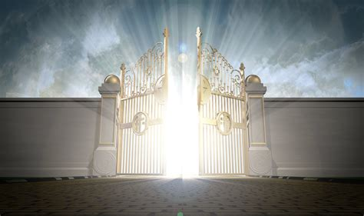
Psalm 24: Lift Up Your Gates and the King of Glory shall come in

Slide 3
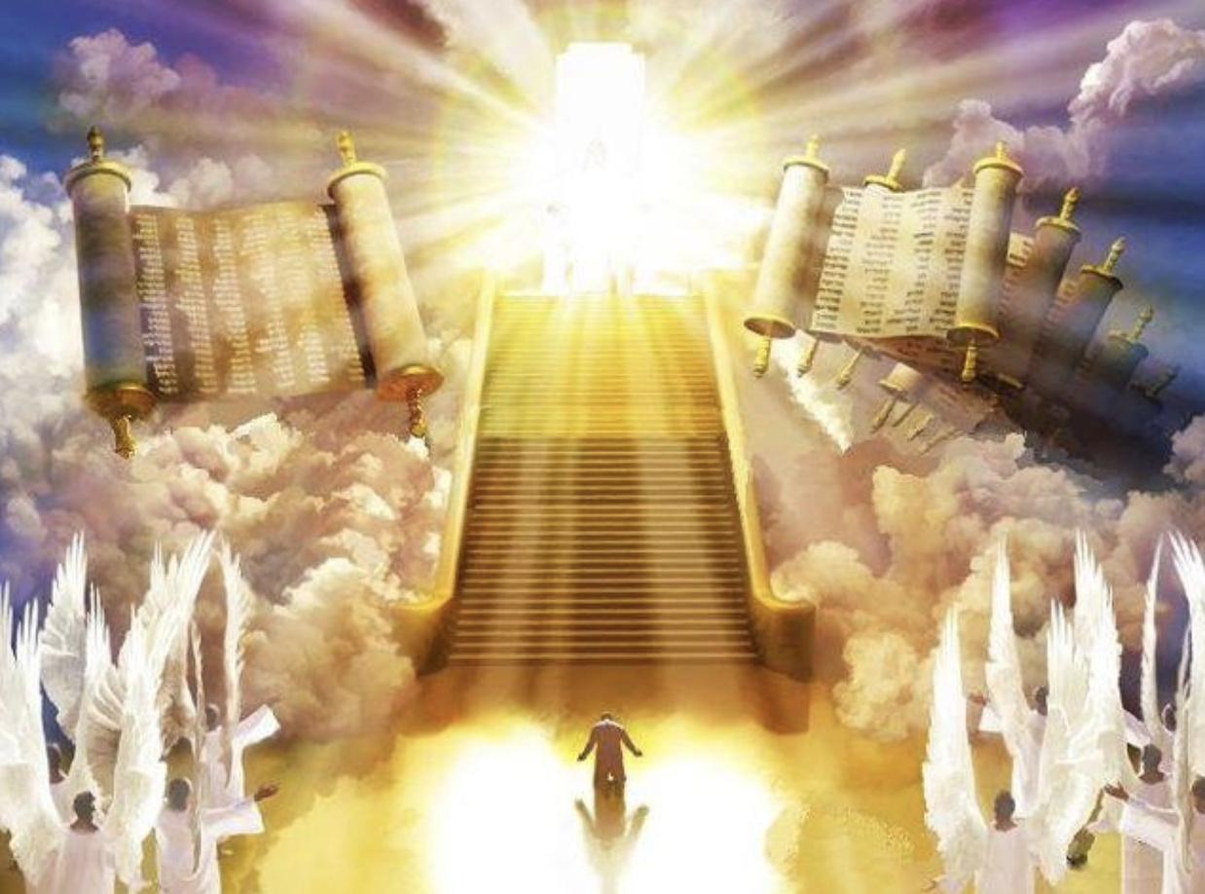
Daniel 7: He came to the Ancient One and was presented before him
Cita Divina: Daniel 7:9-14. Anciano de Días

Slide 4
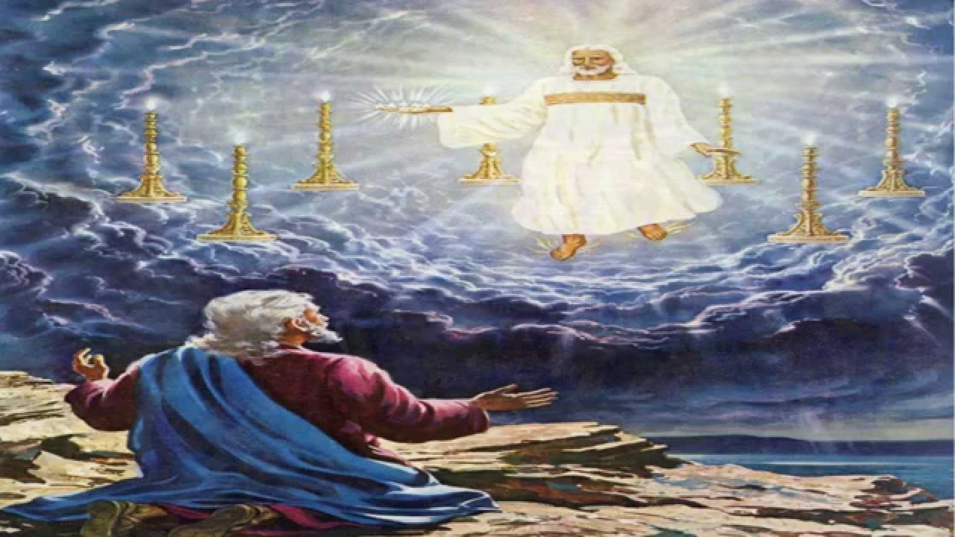
Rev 1: I saw seven candlesticks . . .and one like the Son of Man …
mybiblestoriesblog.blogspot.com

Slide 5
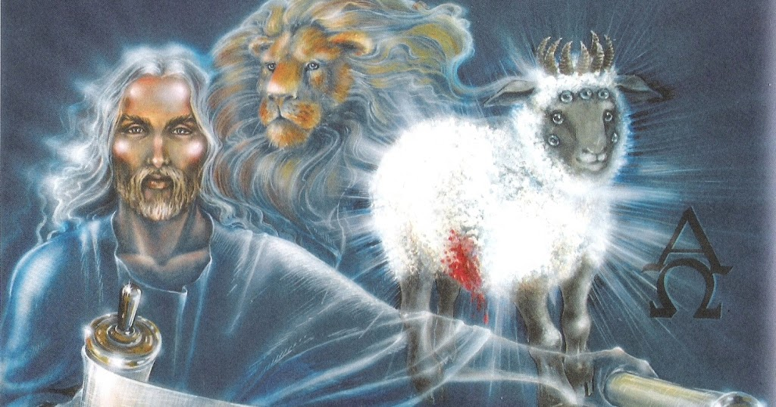
Rev 5: See, the Lion of the Tribe of Judah… then I saw …
a Lamb standing as if it had been slaughtered

Slide 6
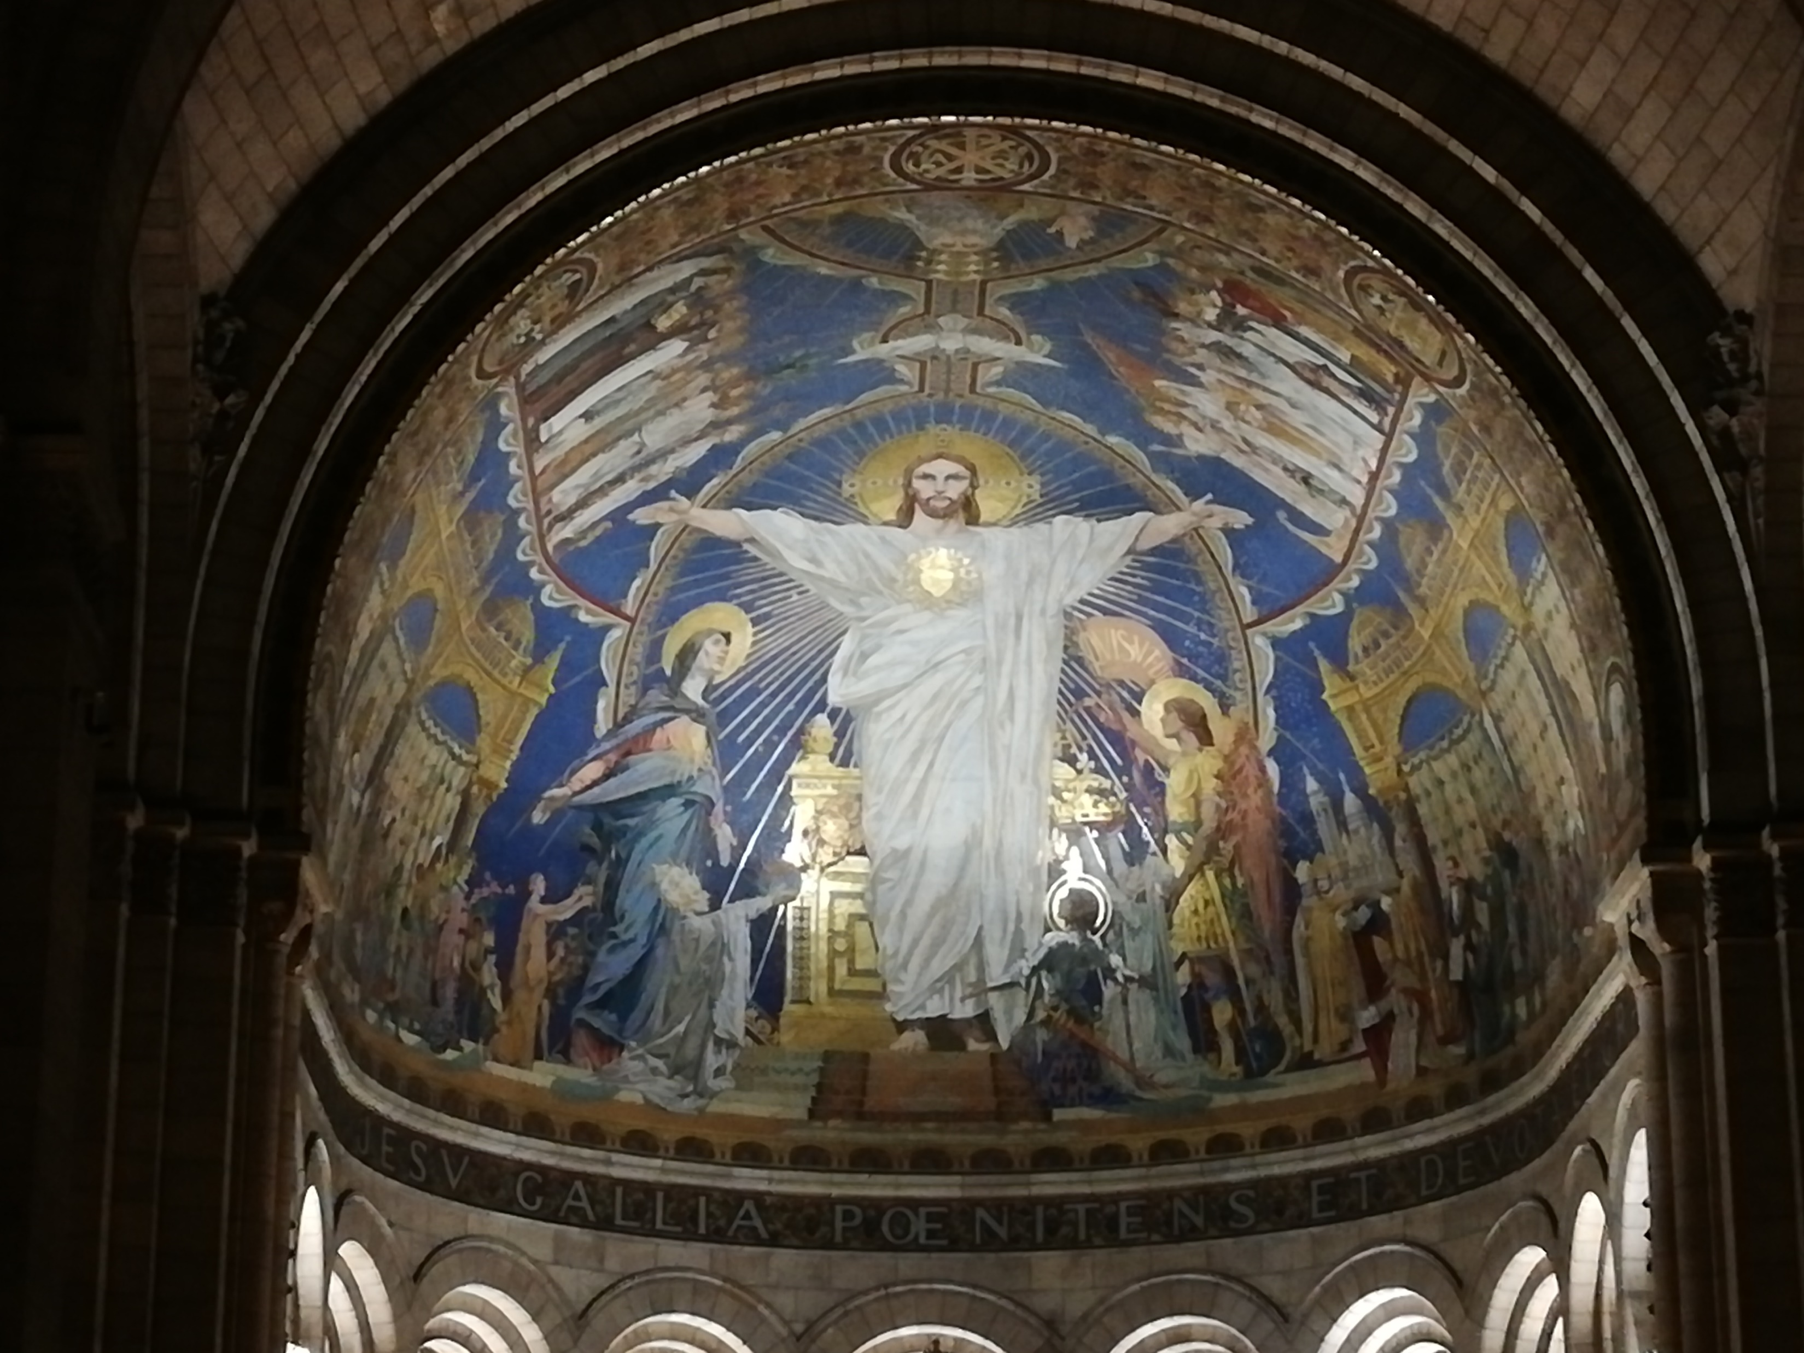
Heb 6, 8: Jesus … having become a High Priest for ever …
entered into the Holy Place … now to appear
in the presence of God on our behalf
Christ In Glory - Sacre Coeur de Montmartre

